Slide 1
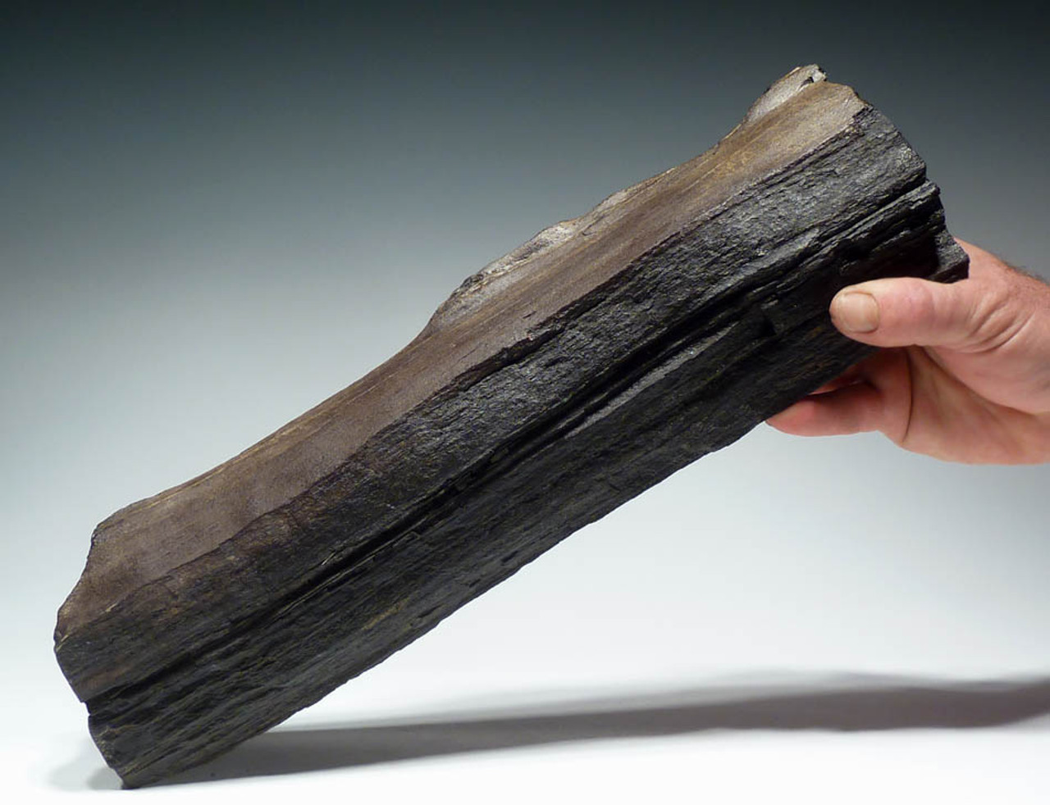
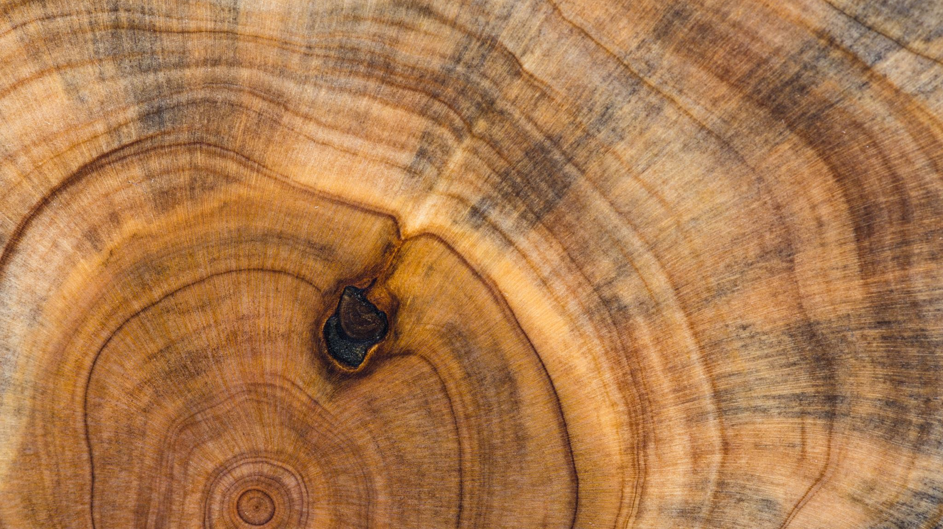
Anomaly detection in wood Fossil
Anomaly detection in Wood
By : Greeshmanjali
Pranay Bhakthula

Slide 2
Introduction
Based on paper ‘Chimpanzee wooden tool analysis advances the identification of percussive technology’ Co-authored by Prof. Chen Zeng .
In this project we aim to find best method to detect anomalies in the wood; i.e, it can distinguish damaged part of the wood from the undamaged part.
To get to know what is common and distinct among the damaged and undamaged part, and figure out the correlation among 13 haralick features for different species.

Slide 3
Datasets:
Dataset 1:
There are 31 different images of wood species in the dataset .
Dataset 2:
This dataset contain various images of one species named ‘Coula’.

Slide 4
Methods
Dataset1:
Used python libraries to mark and trim the damaged and undamaged area.
Generated cuts (1 mm to 9mm) on the damaged and undamaged part of the wood
Performed EDA to generate the density plots for the 13 haralick features.
Dataset2:
Performed EDA to generate the density plots for the 13 haralick features.
Calculated Gray-Level Co-occurrence Matrix (GLCM) for 13 haralick features.

Slide 5
Dataset-1

Slide 6
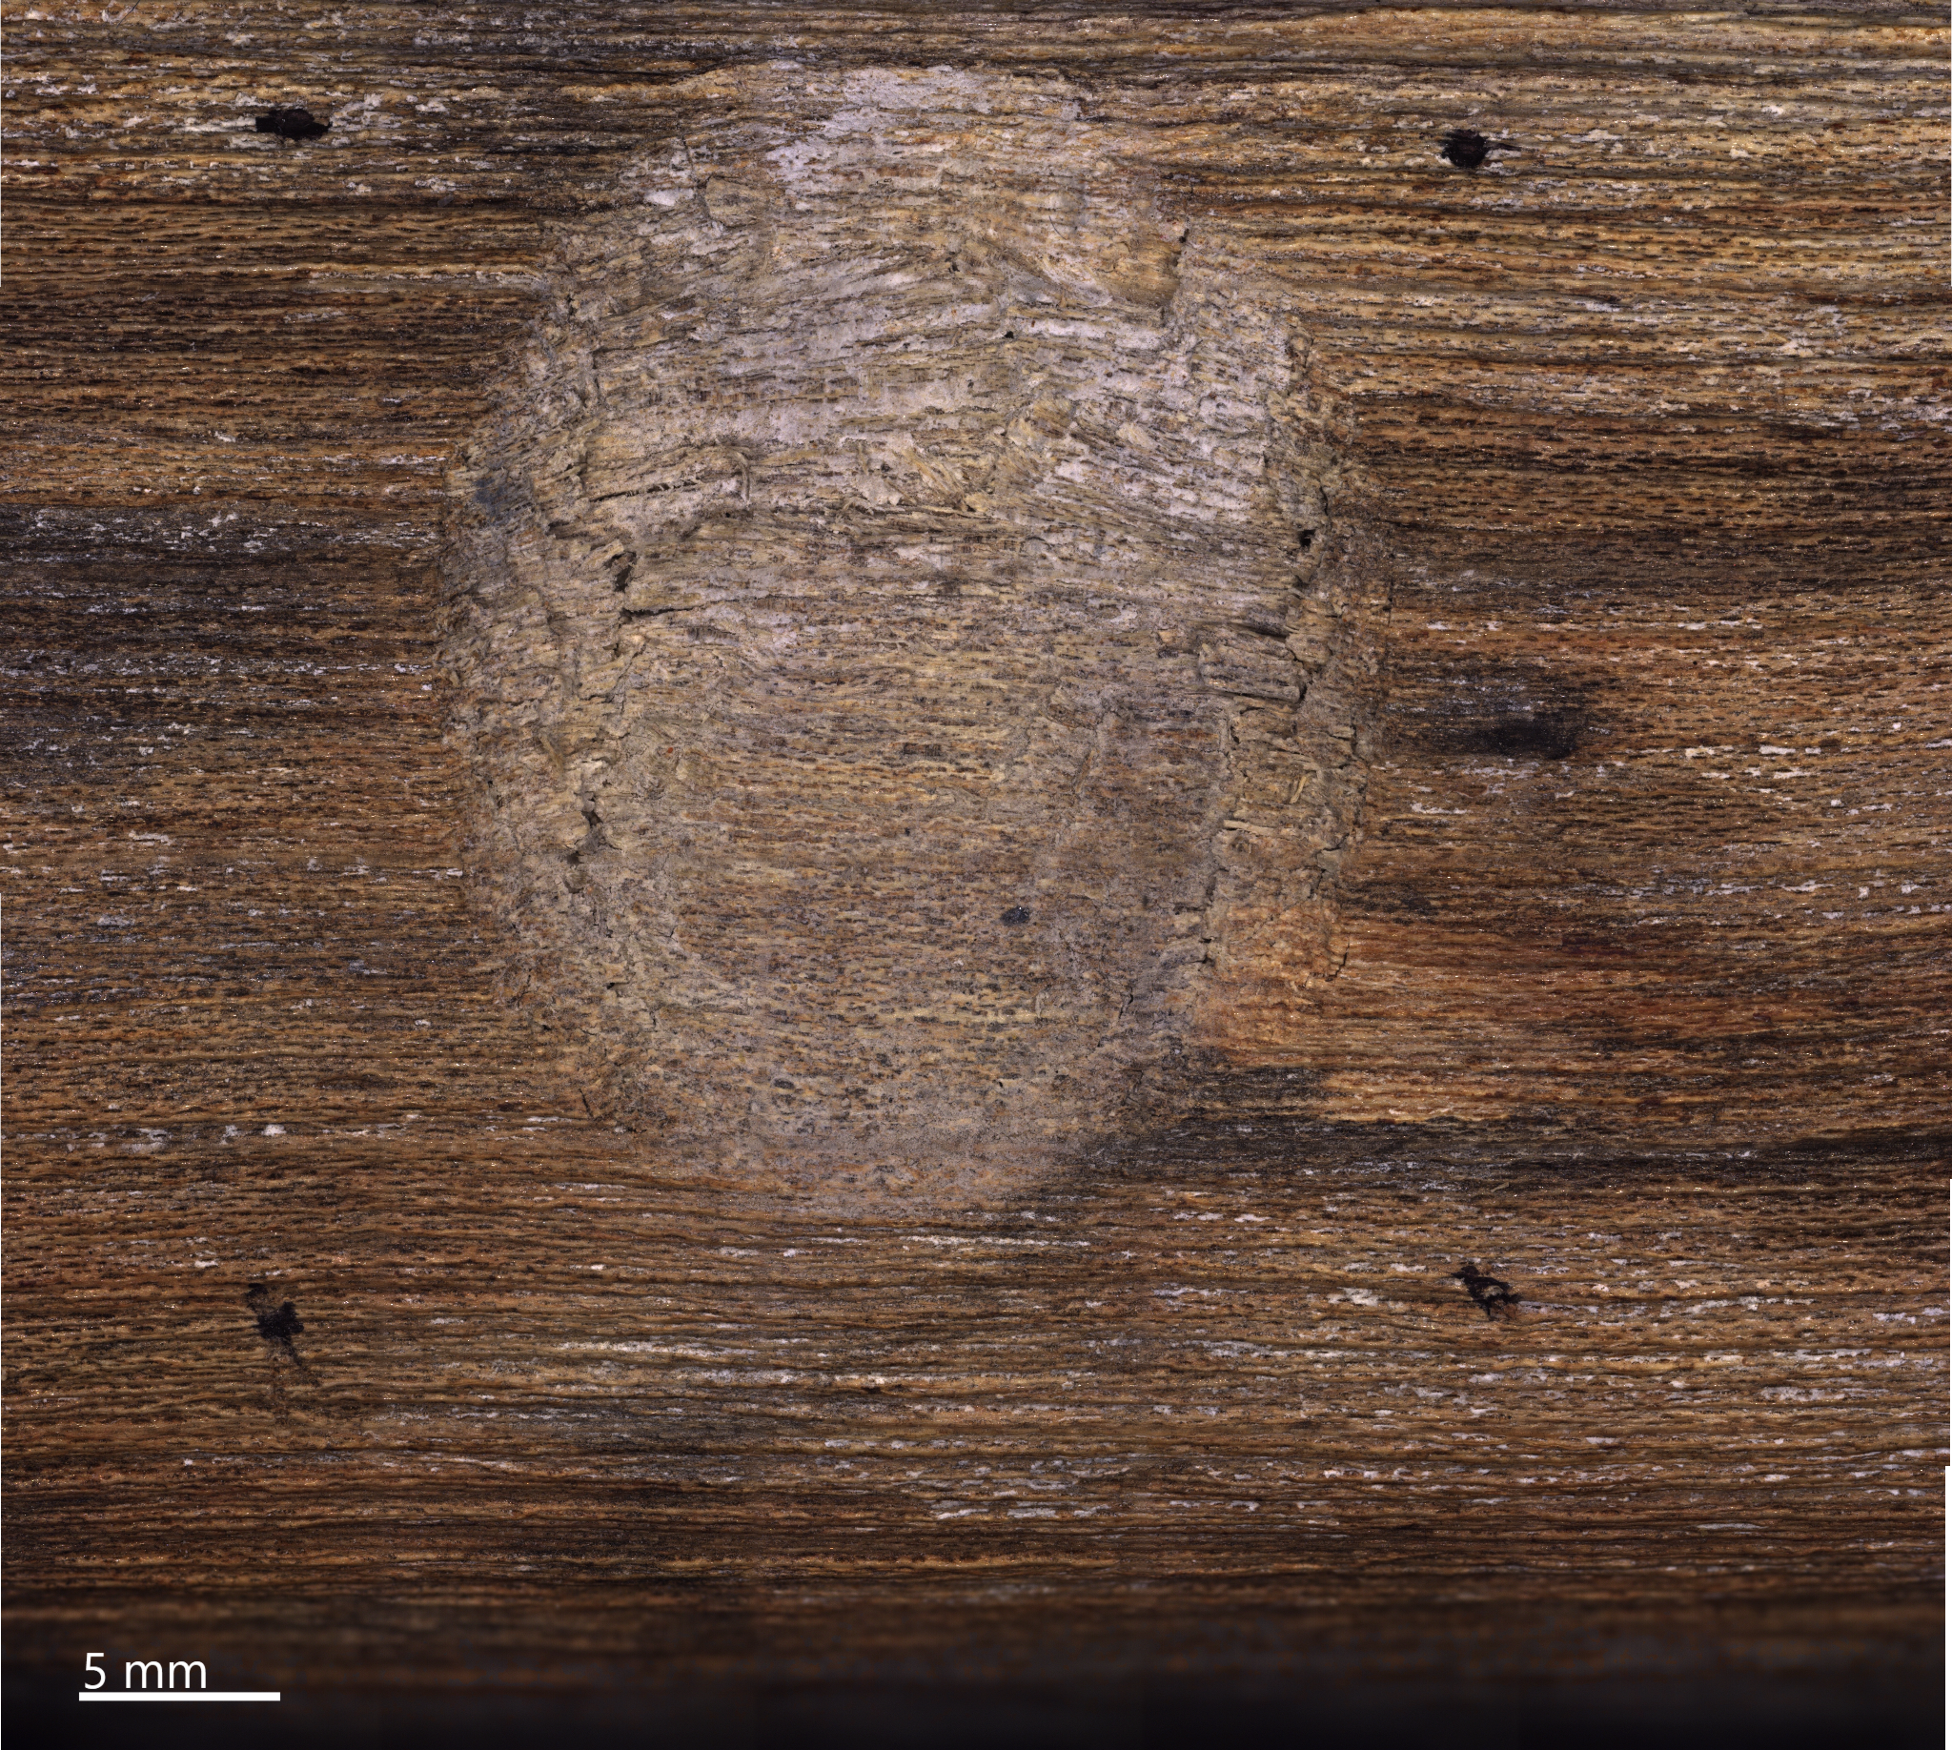
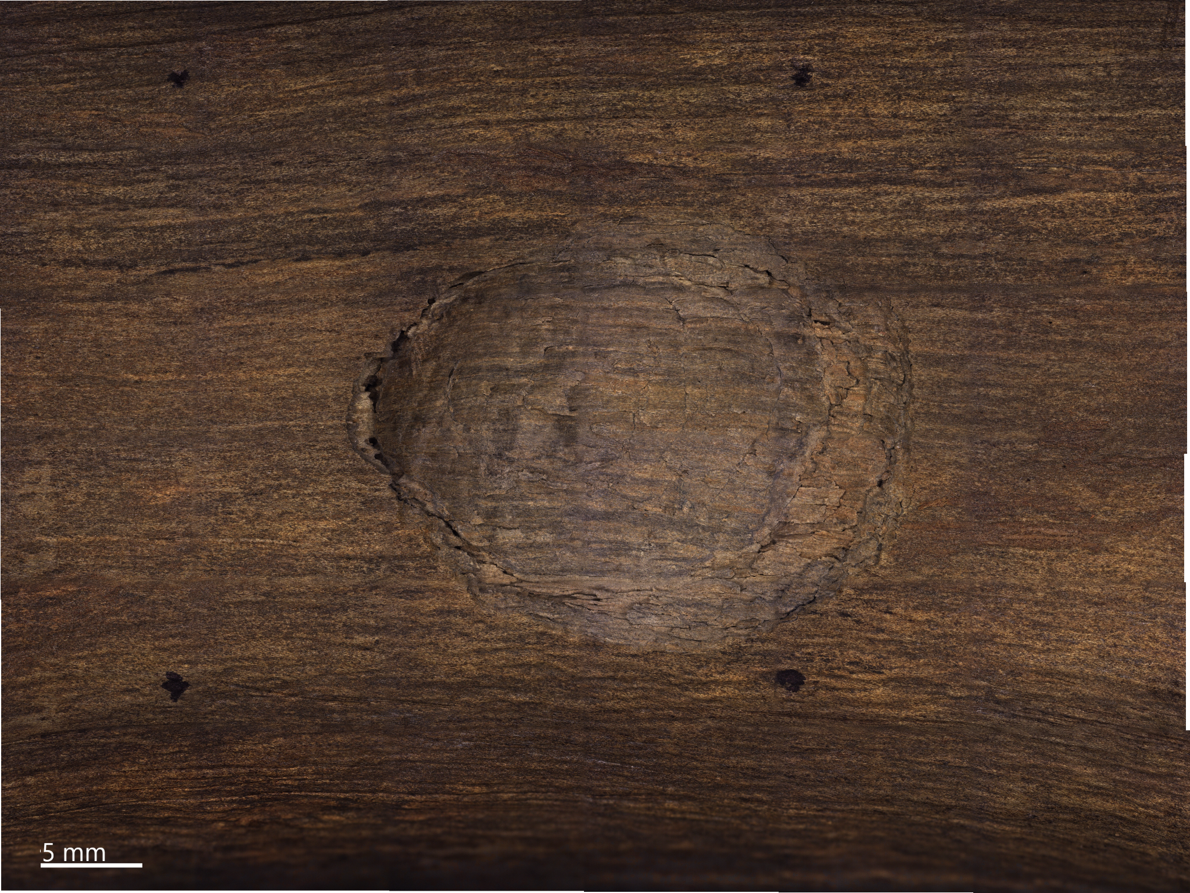
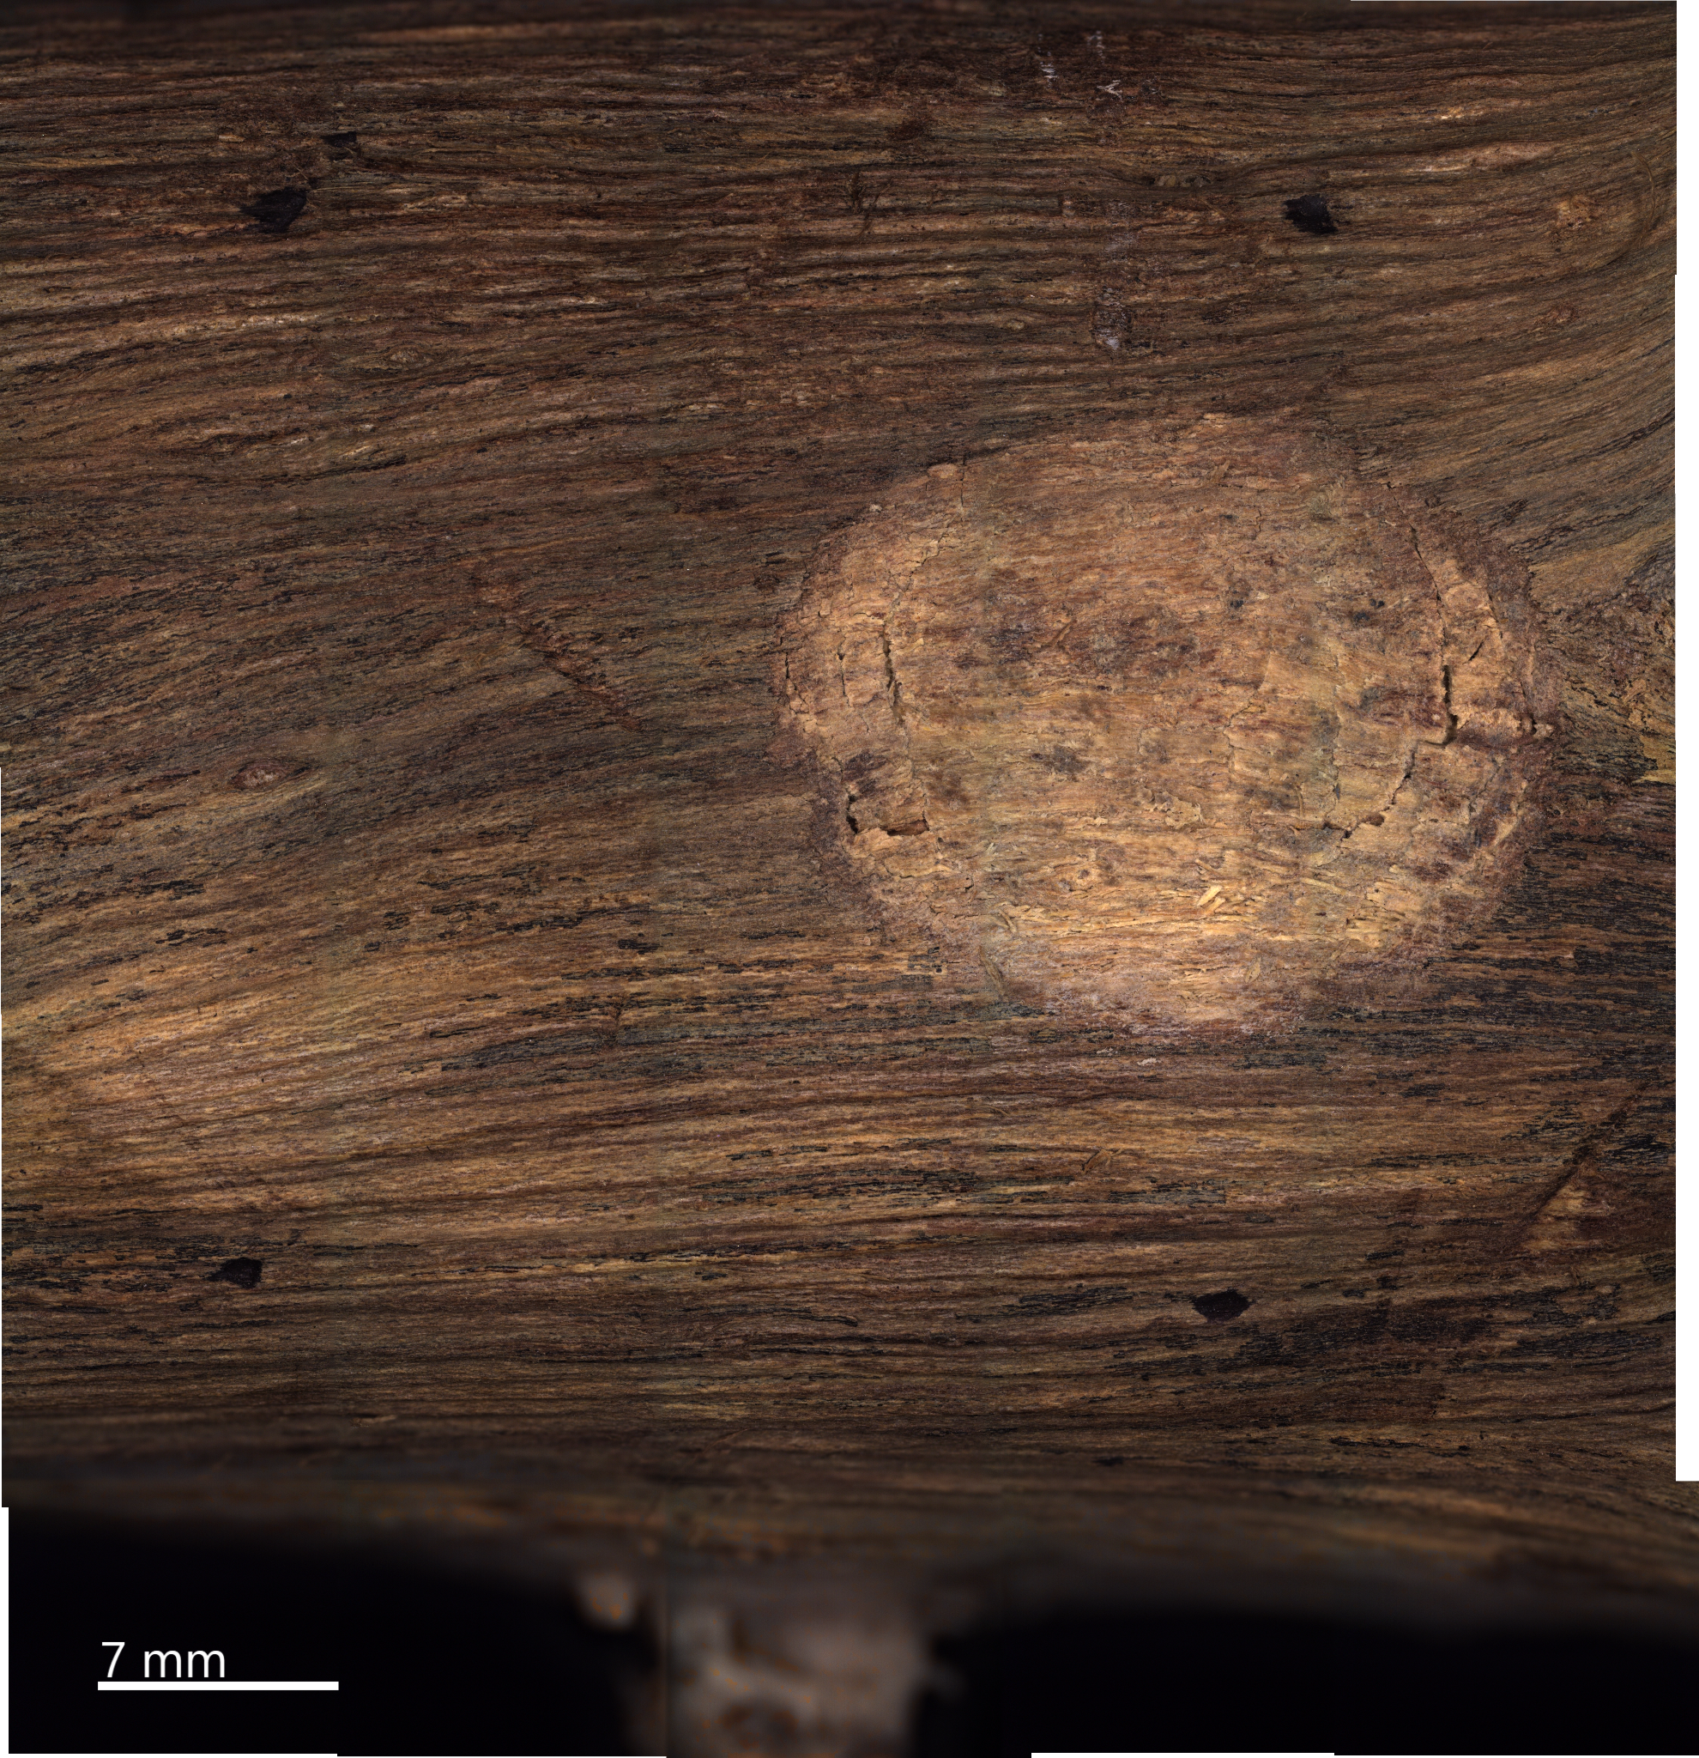

Slide 7
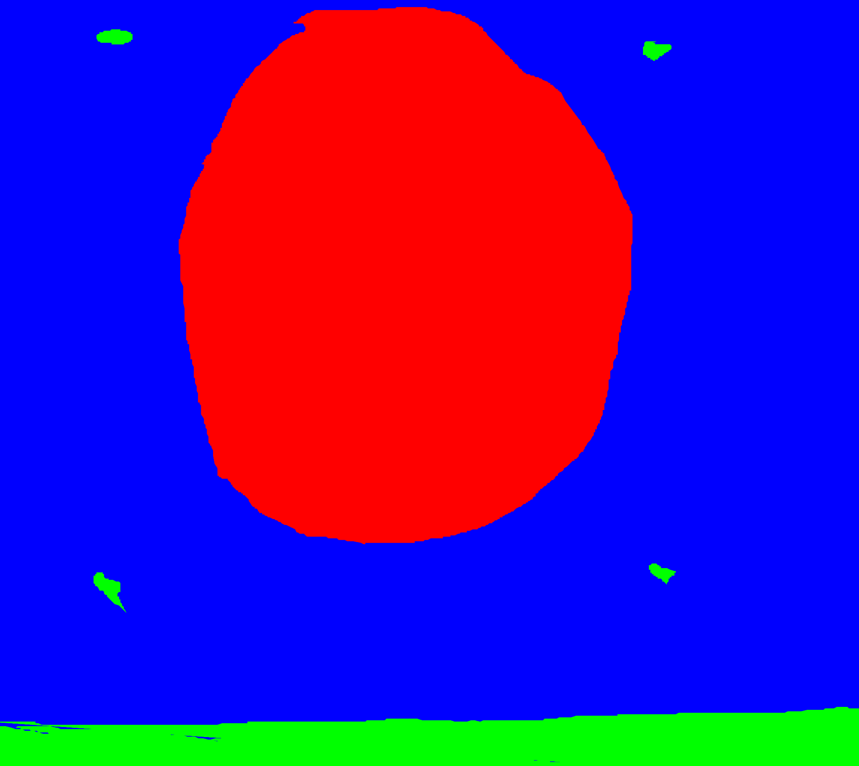
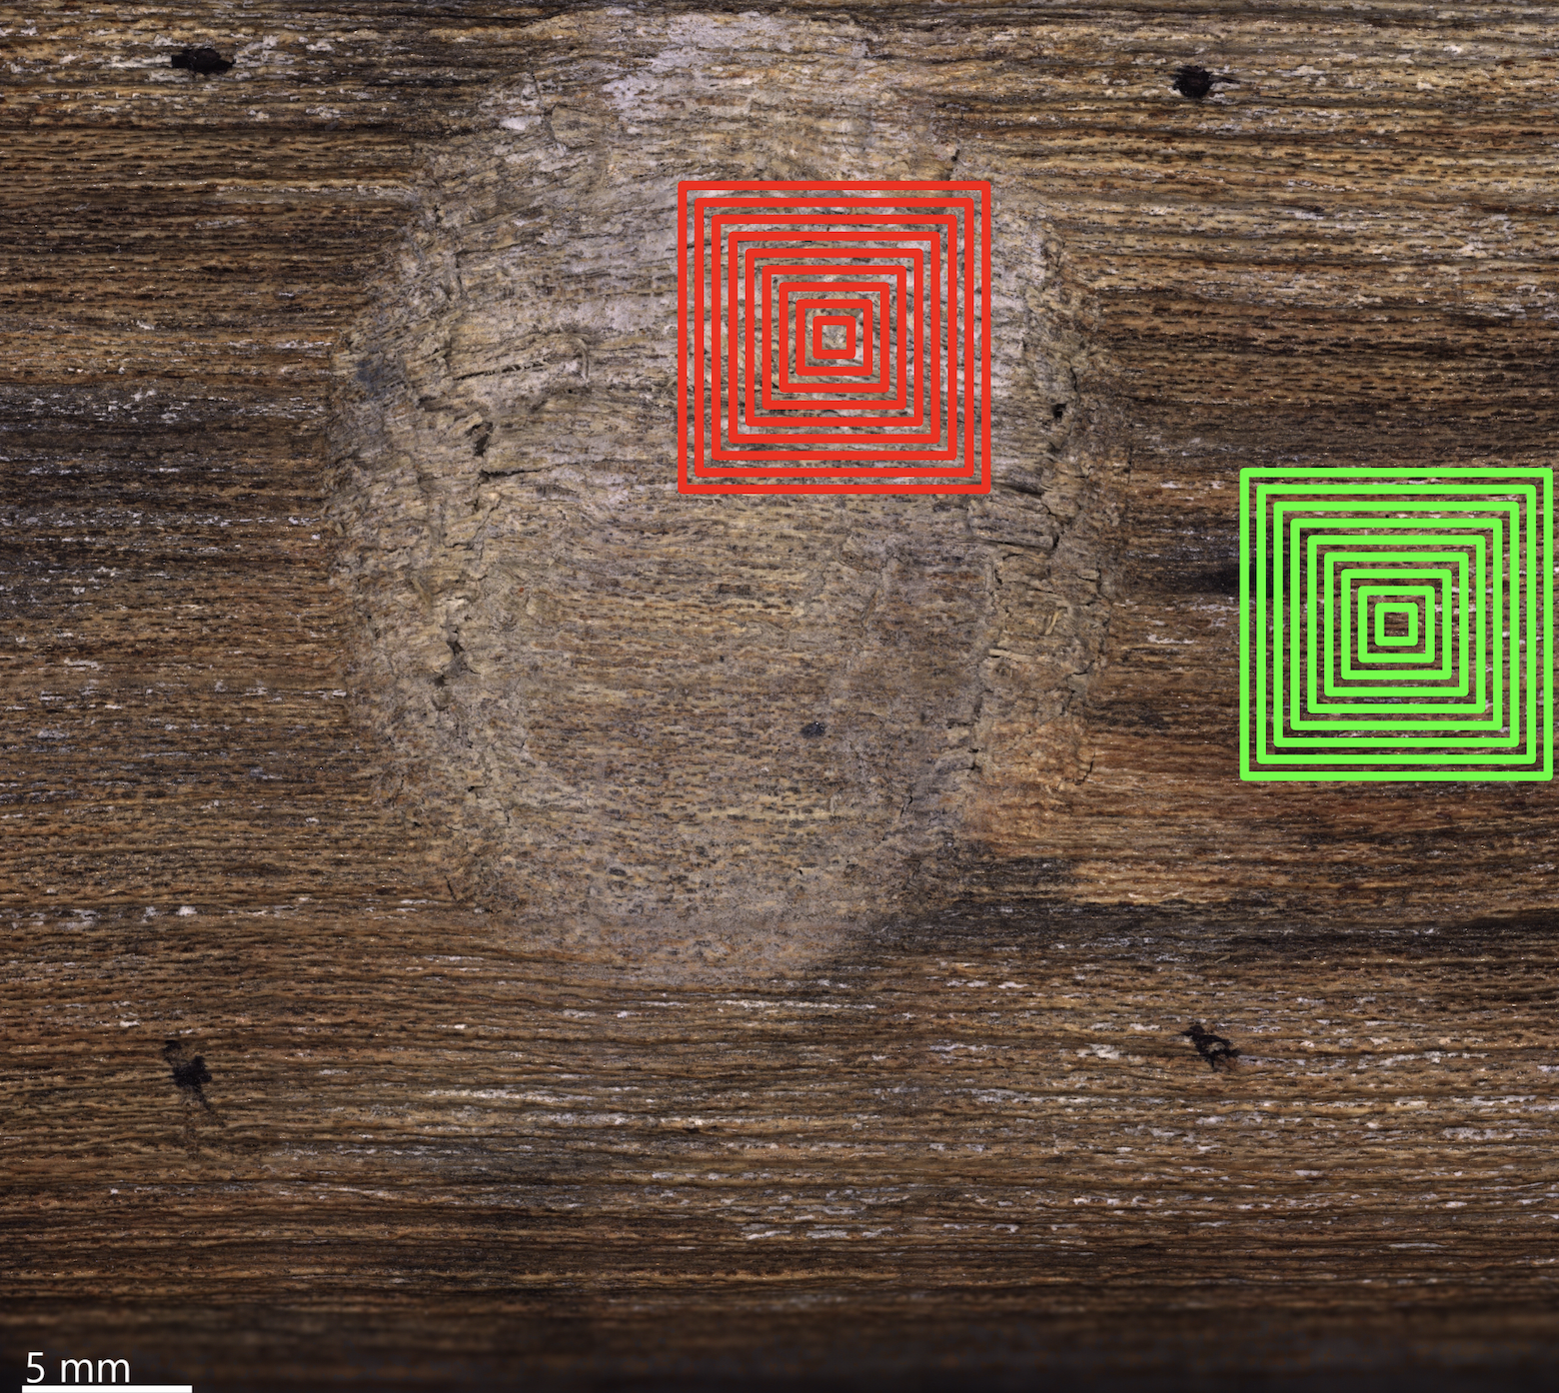
AX2_7316_747_5
I marked the image; here red indicates the damaged area, blue indicates the undamaged area and green is the non-wood.
I generated cuts from 1 mm - 9mm for all the species

Slide 8
What are haralick features?
Haralick texture features are common texture descriptors in image analysis. To compute the Haralick features, the image gray-levels are reduced, a process called quantization. The resulting features depend heavily on the quantization step, so Haralick features are not reproducible unless the same quantization is performed. The Haralick texture features are functions of the normalized GLCM, where different aspects of the gray-level distribution in the ROI are represented. For example, diagonal elements in the GLCM represent voxels pairs with equal gray-levels.

Slide 9
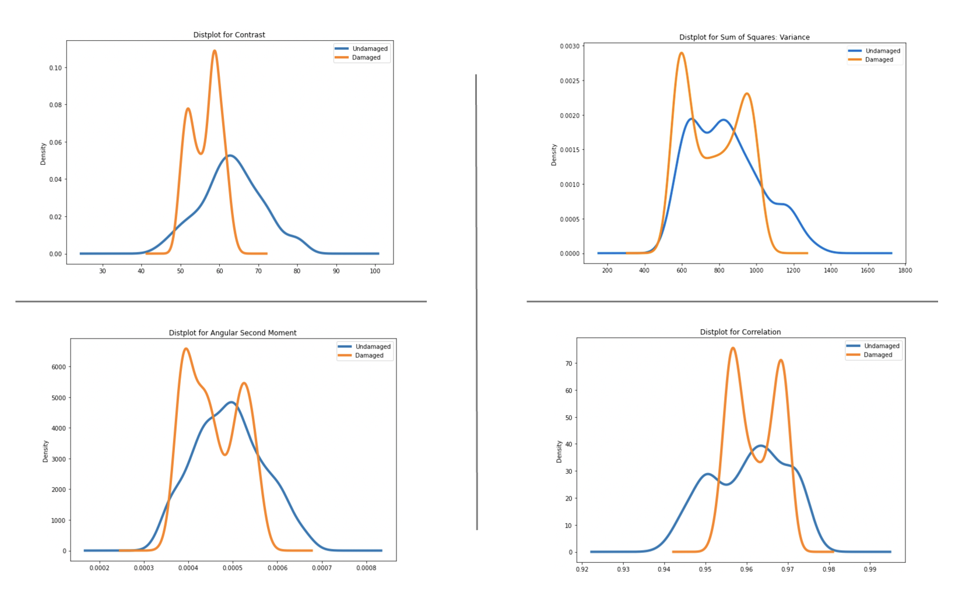

Slide 10
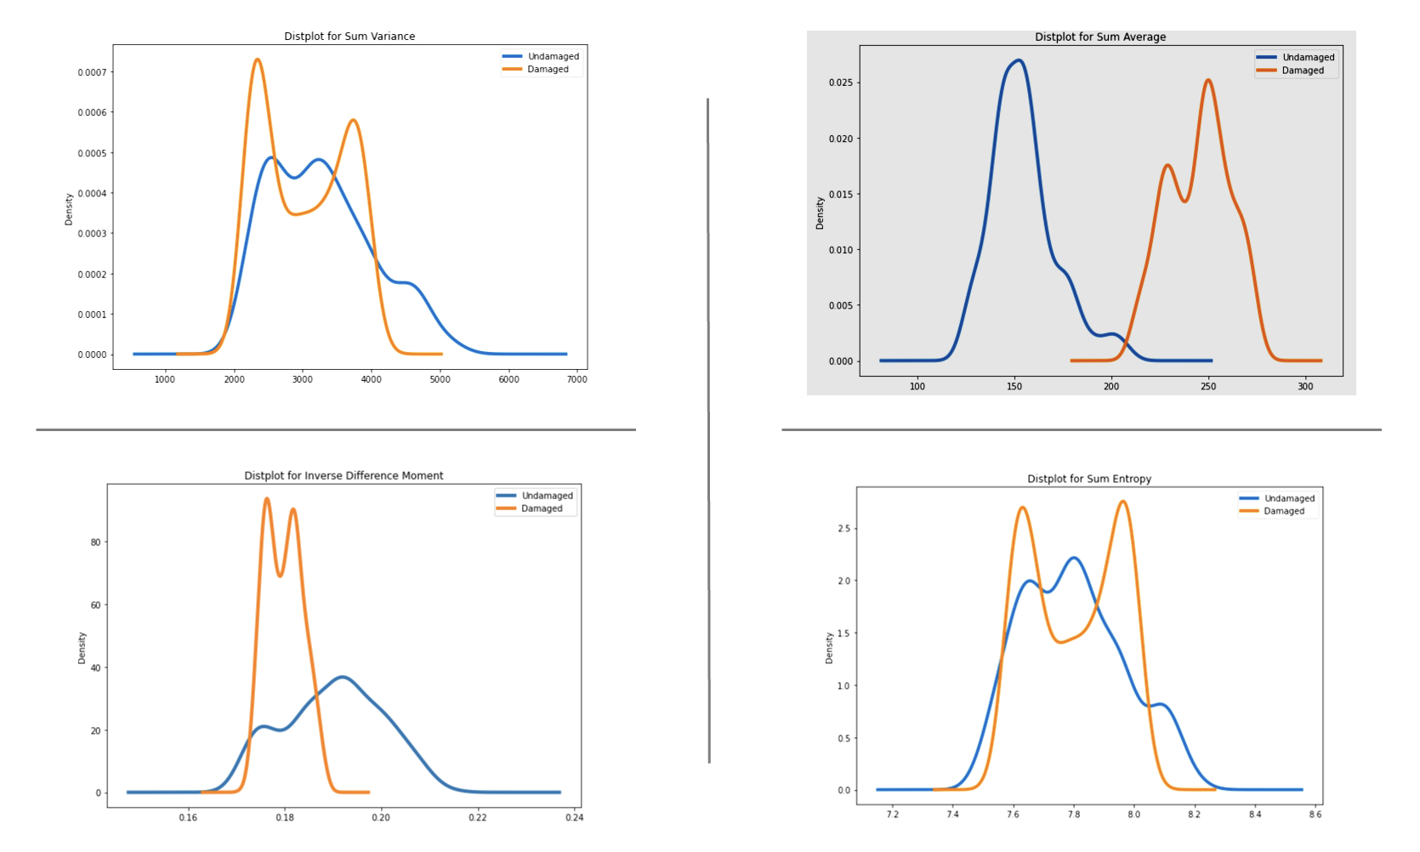

Slide 11
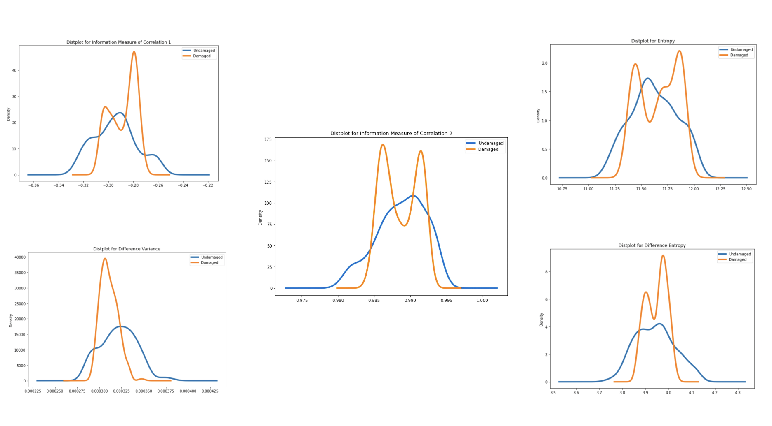

Slide 12
Dataset 2

Slide 13
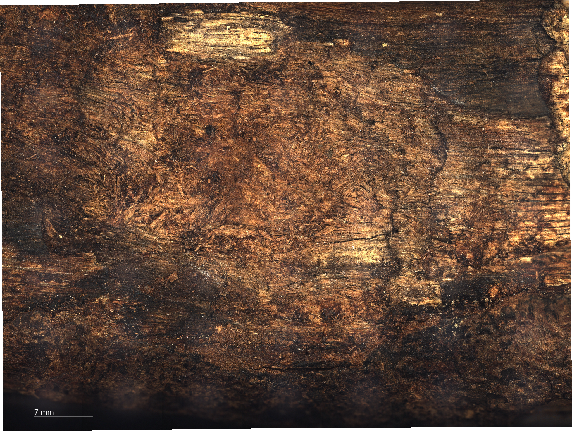
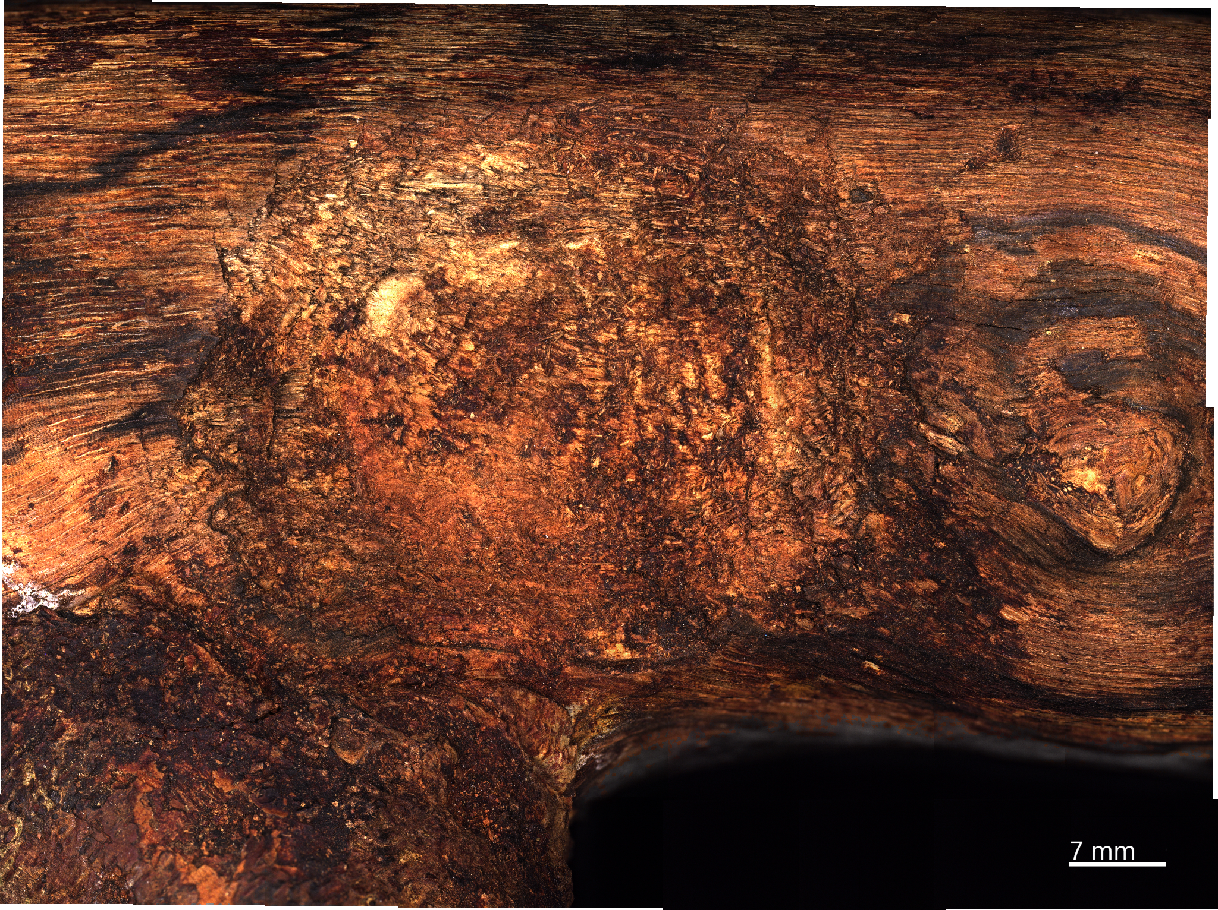
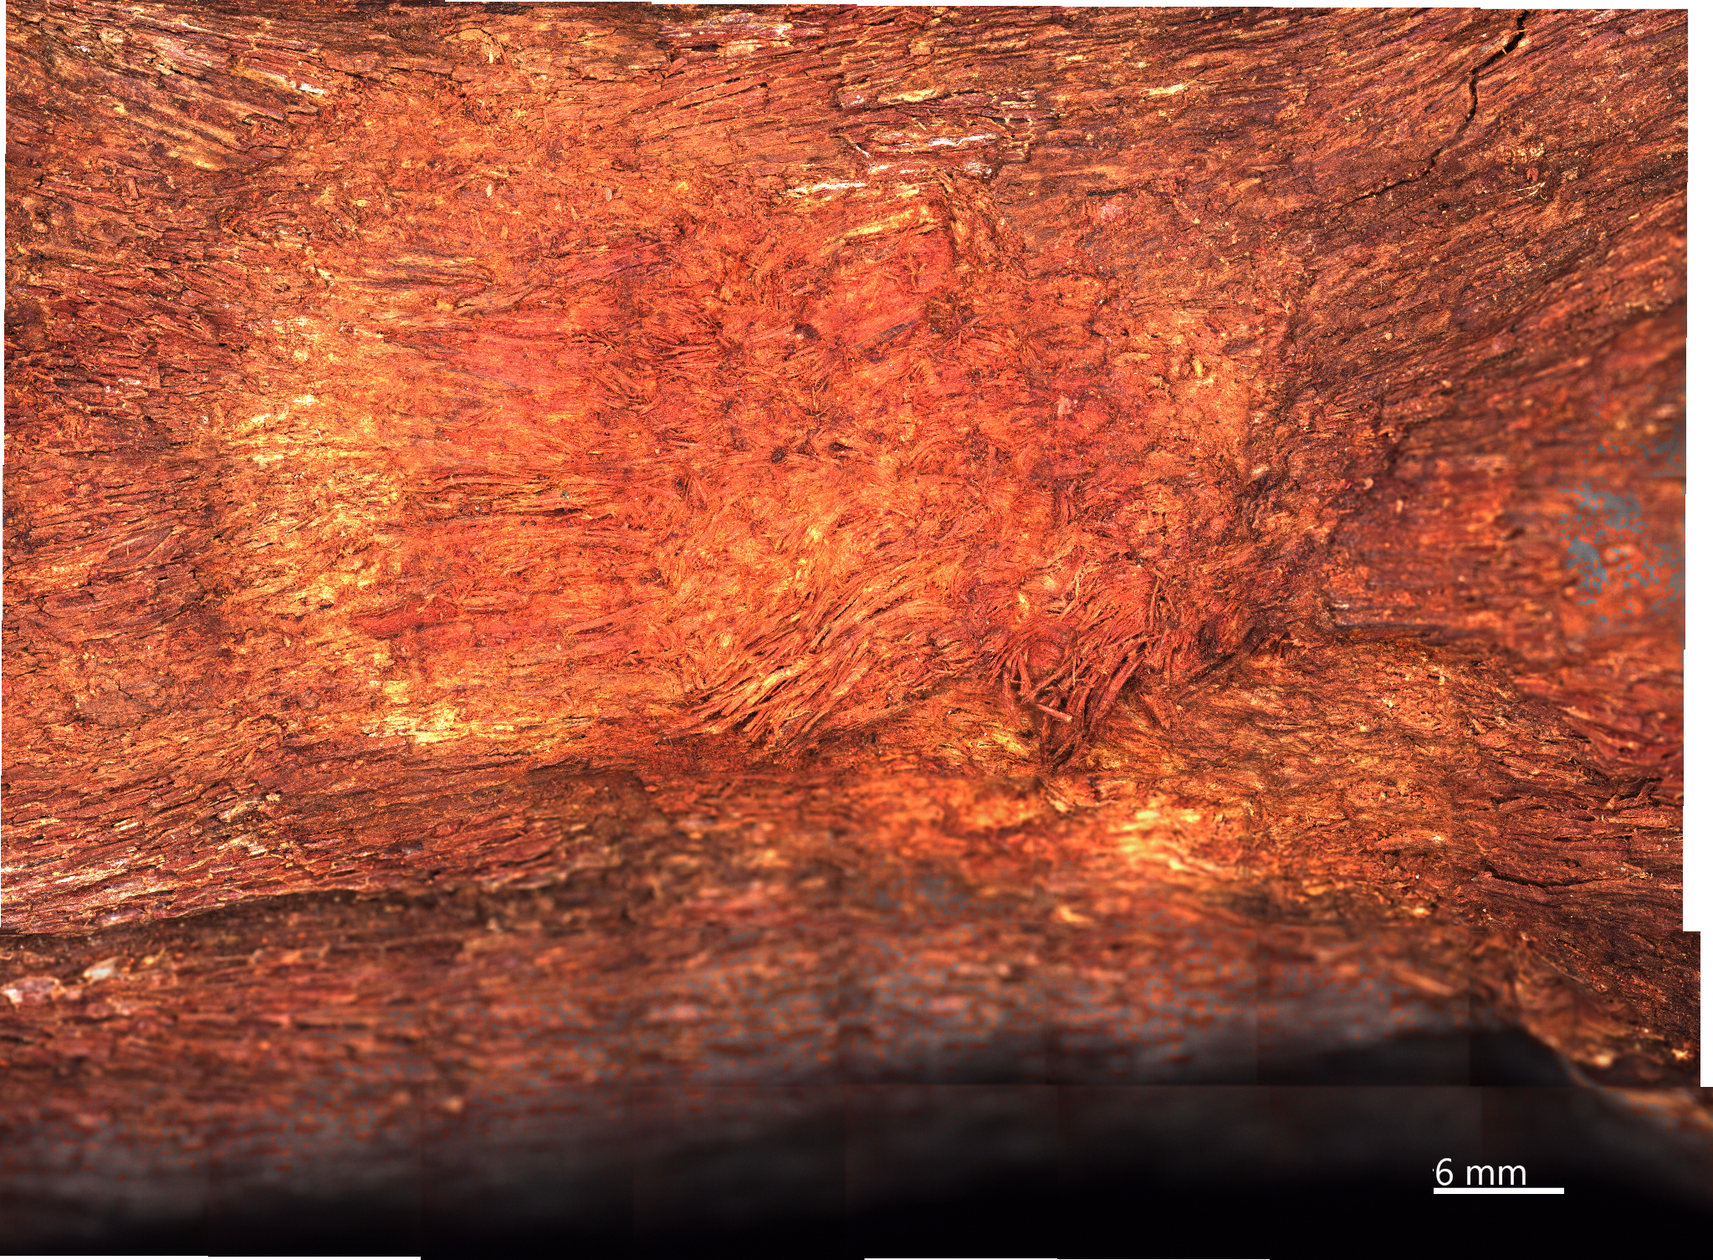

Slide 14
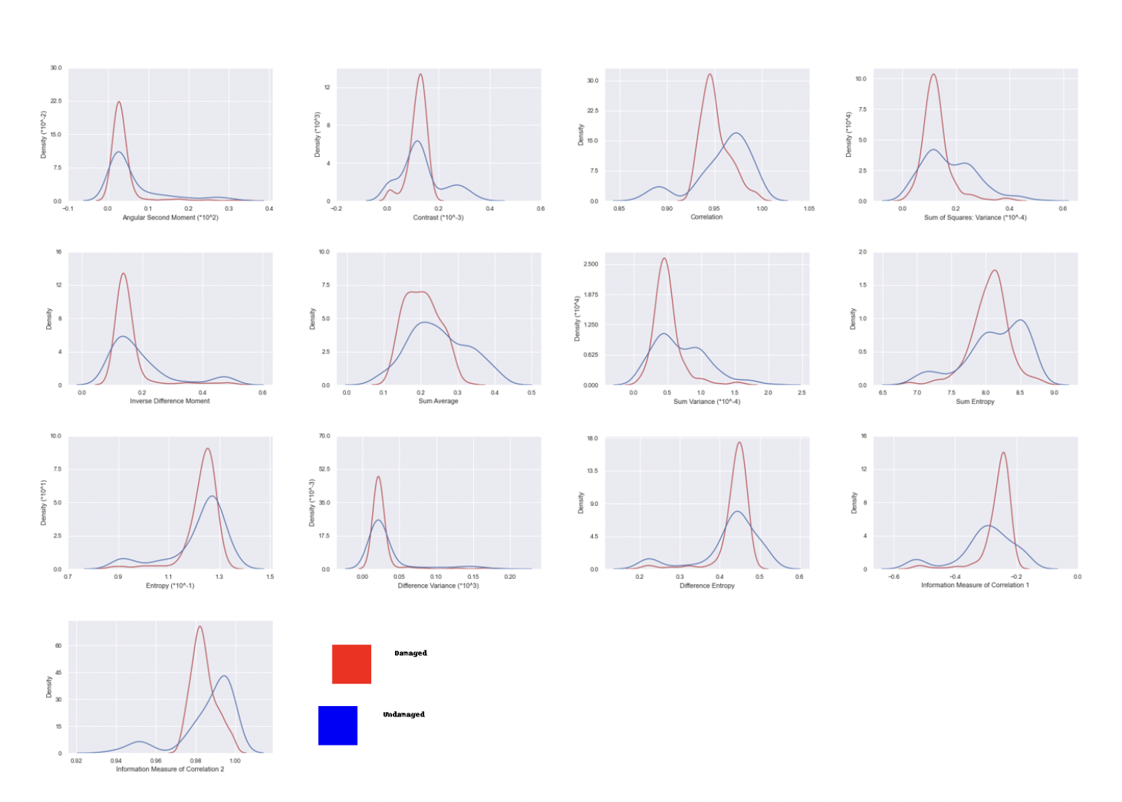
Density plots

Slide 15
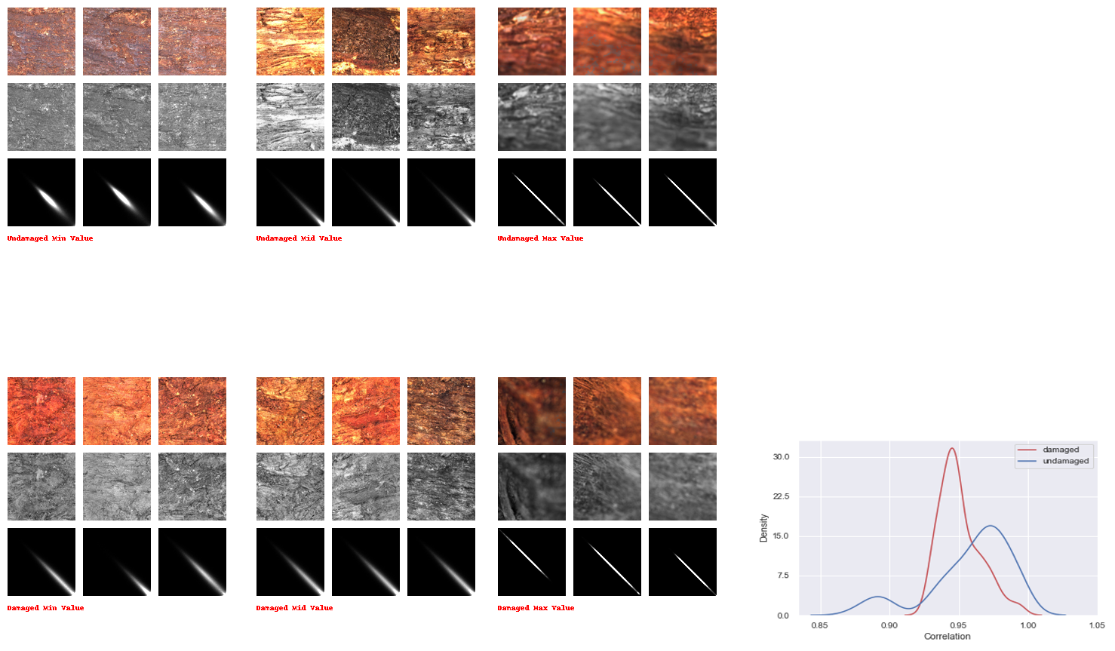

Slide 16
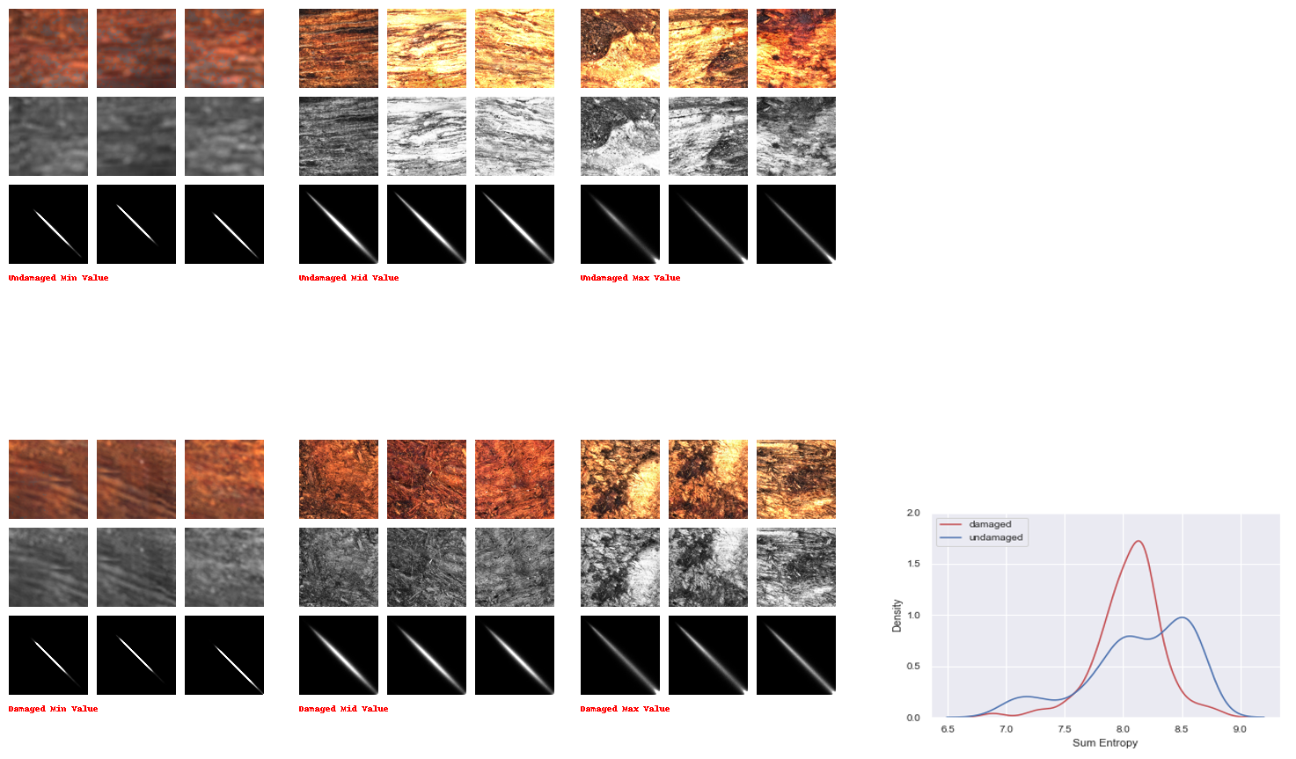

Slide 17
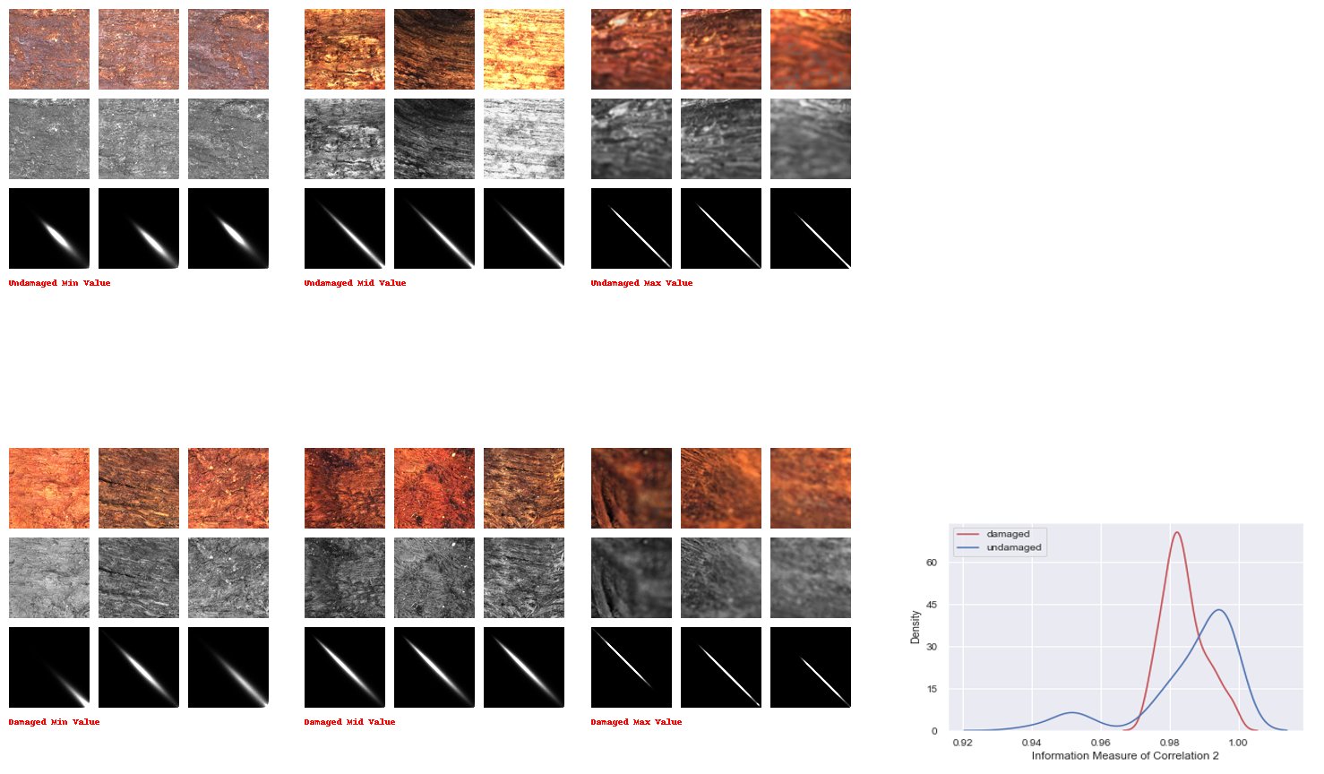

Slide 18
Dataset : Fossil wood
The dataset contains images of 7 different types of fossil woods. Of them 6 are undamaged fossils and 1 is damaged fossil which is the target image on which we will do our analysis on.
The fossil woods are over 4 million years ago.

Slide 19
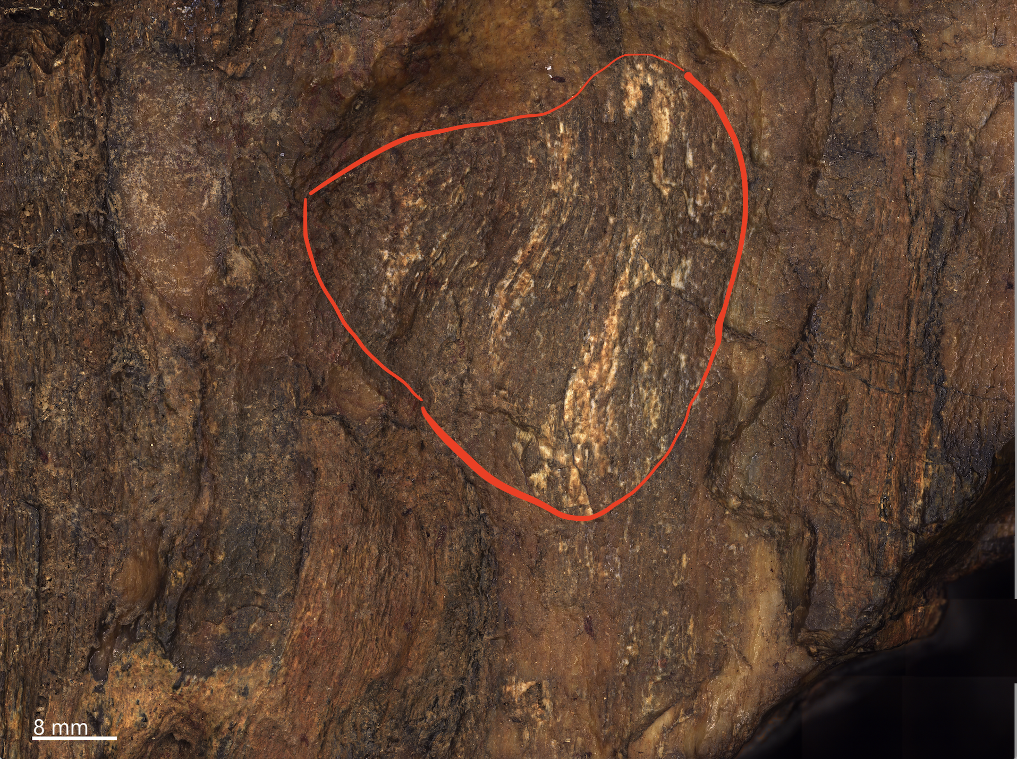
The damaged part of the image is inside the painted region.
Rest of the image is undamaged part
Created a dataset with 1mm, 3mm, 5mm and 7mm cut images of damaged and undamaged parts

Slide 20
Methods
Extracted haralick features and applied PCA to distinguish between damaged and undamaged part of the image
Applied Gram matrix on outputs of pre-trained models like Resnet50 and VGG19 to extract patterns of the image and used PCA to distinguish between damaged and undamaged part of the image.

Slide 21
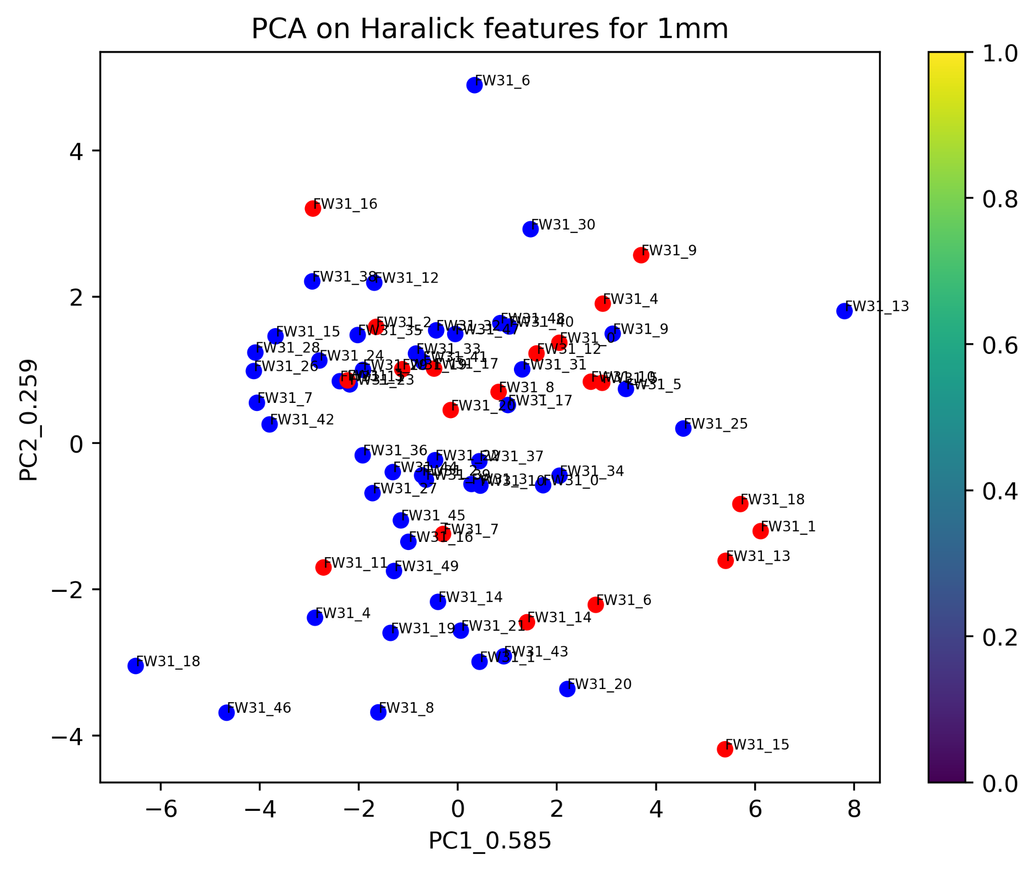
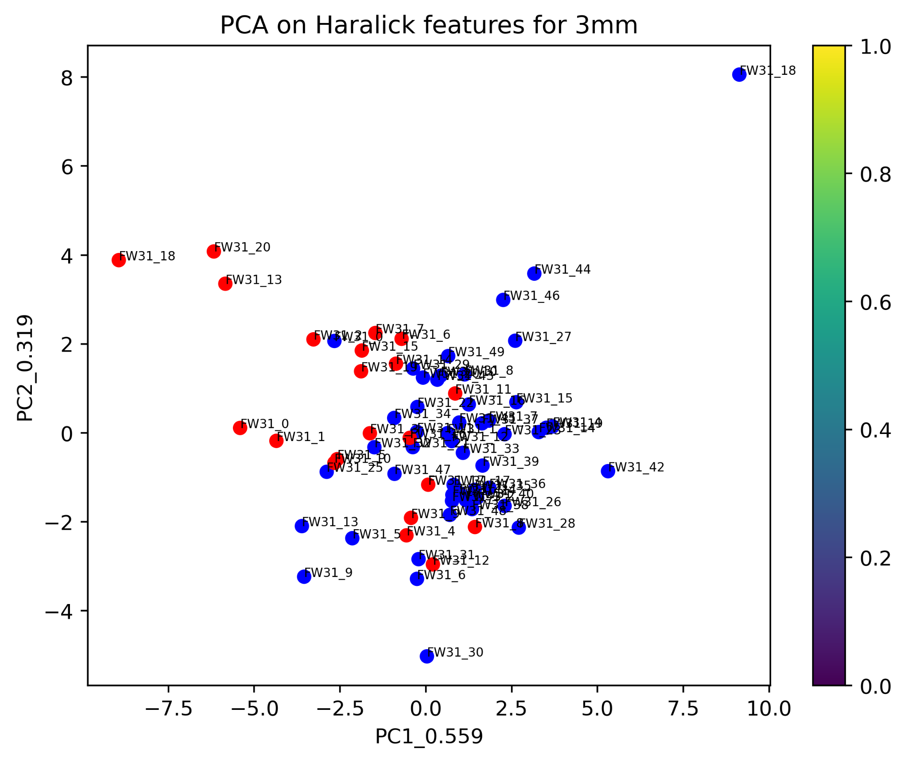
PCA on Haralick features

Slide 22
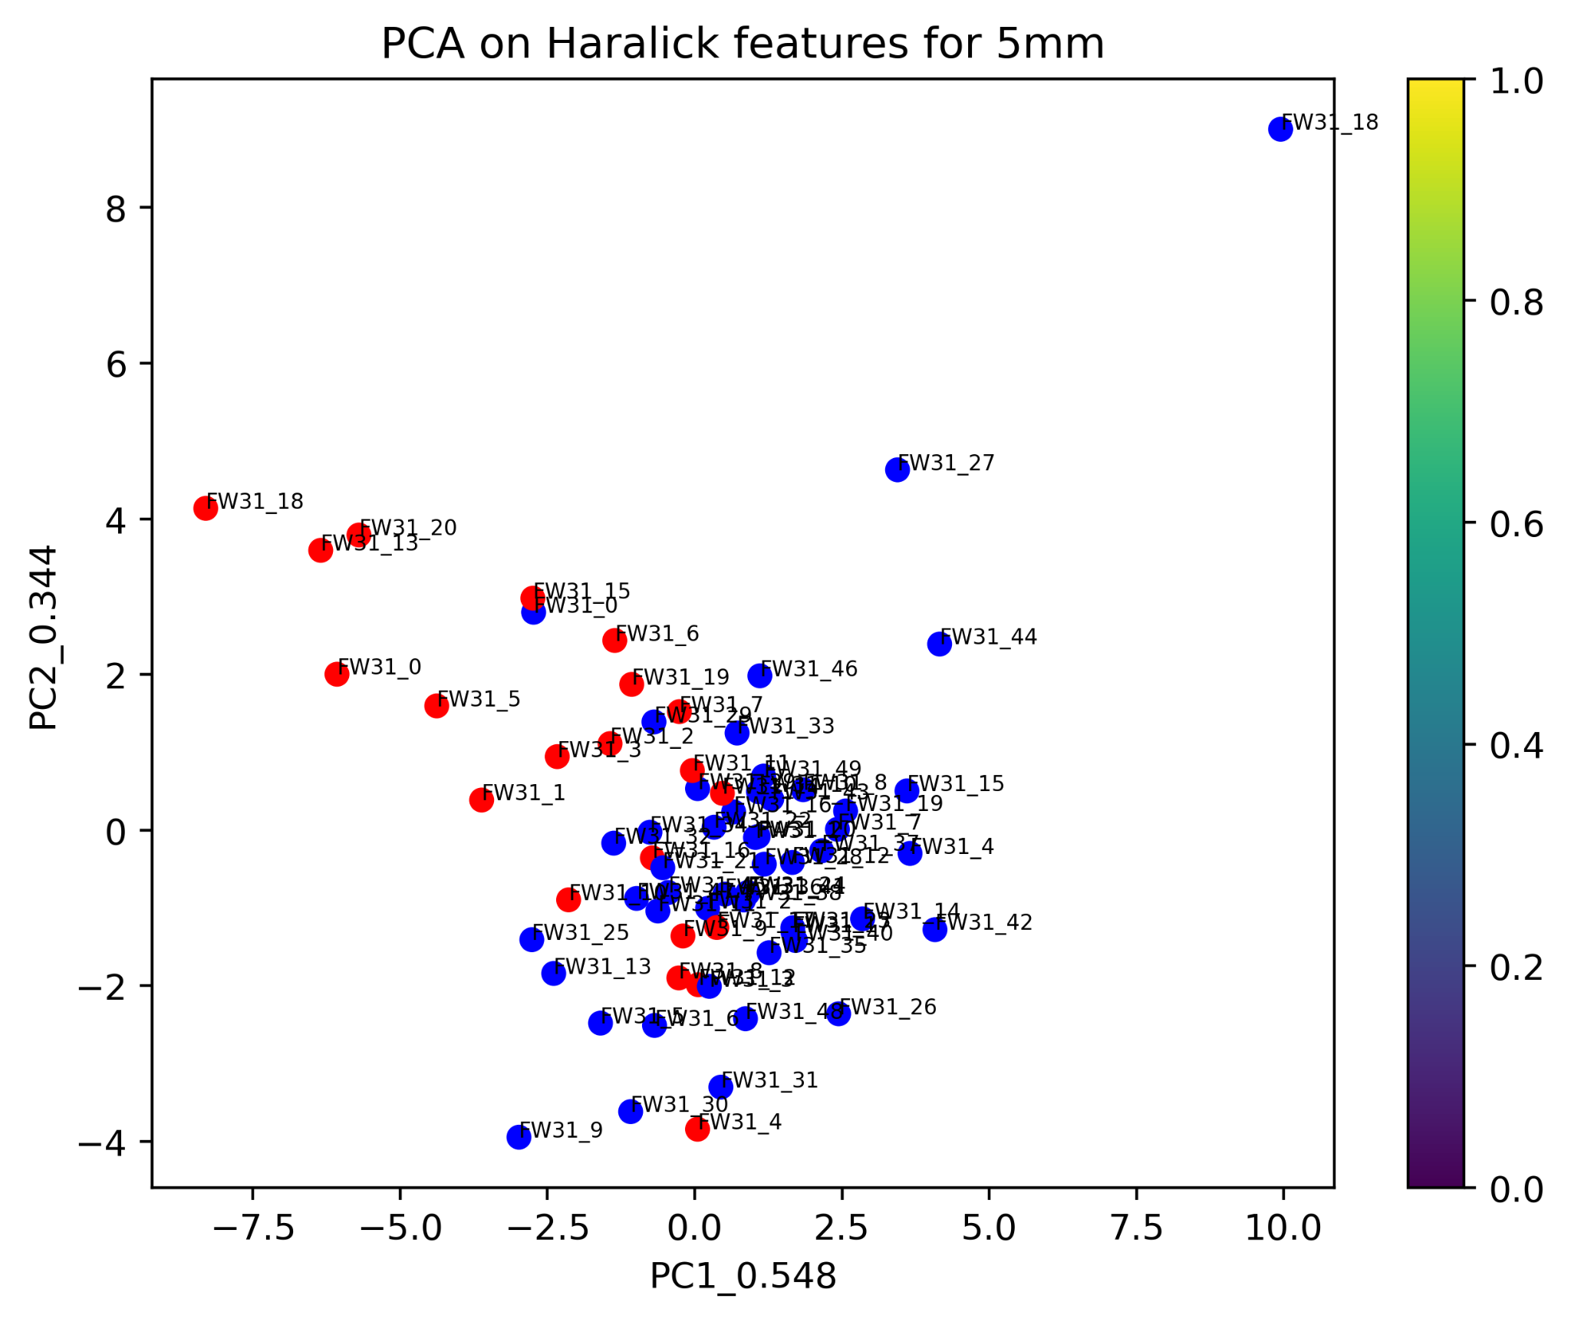
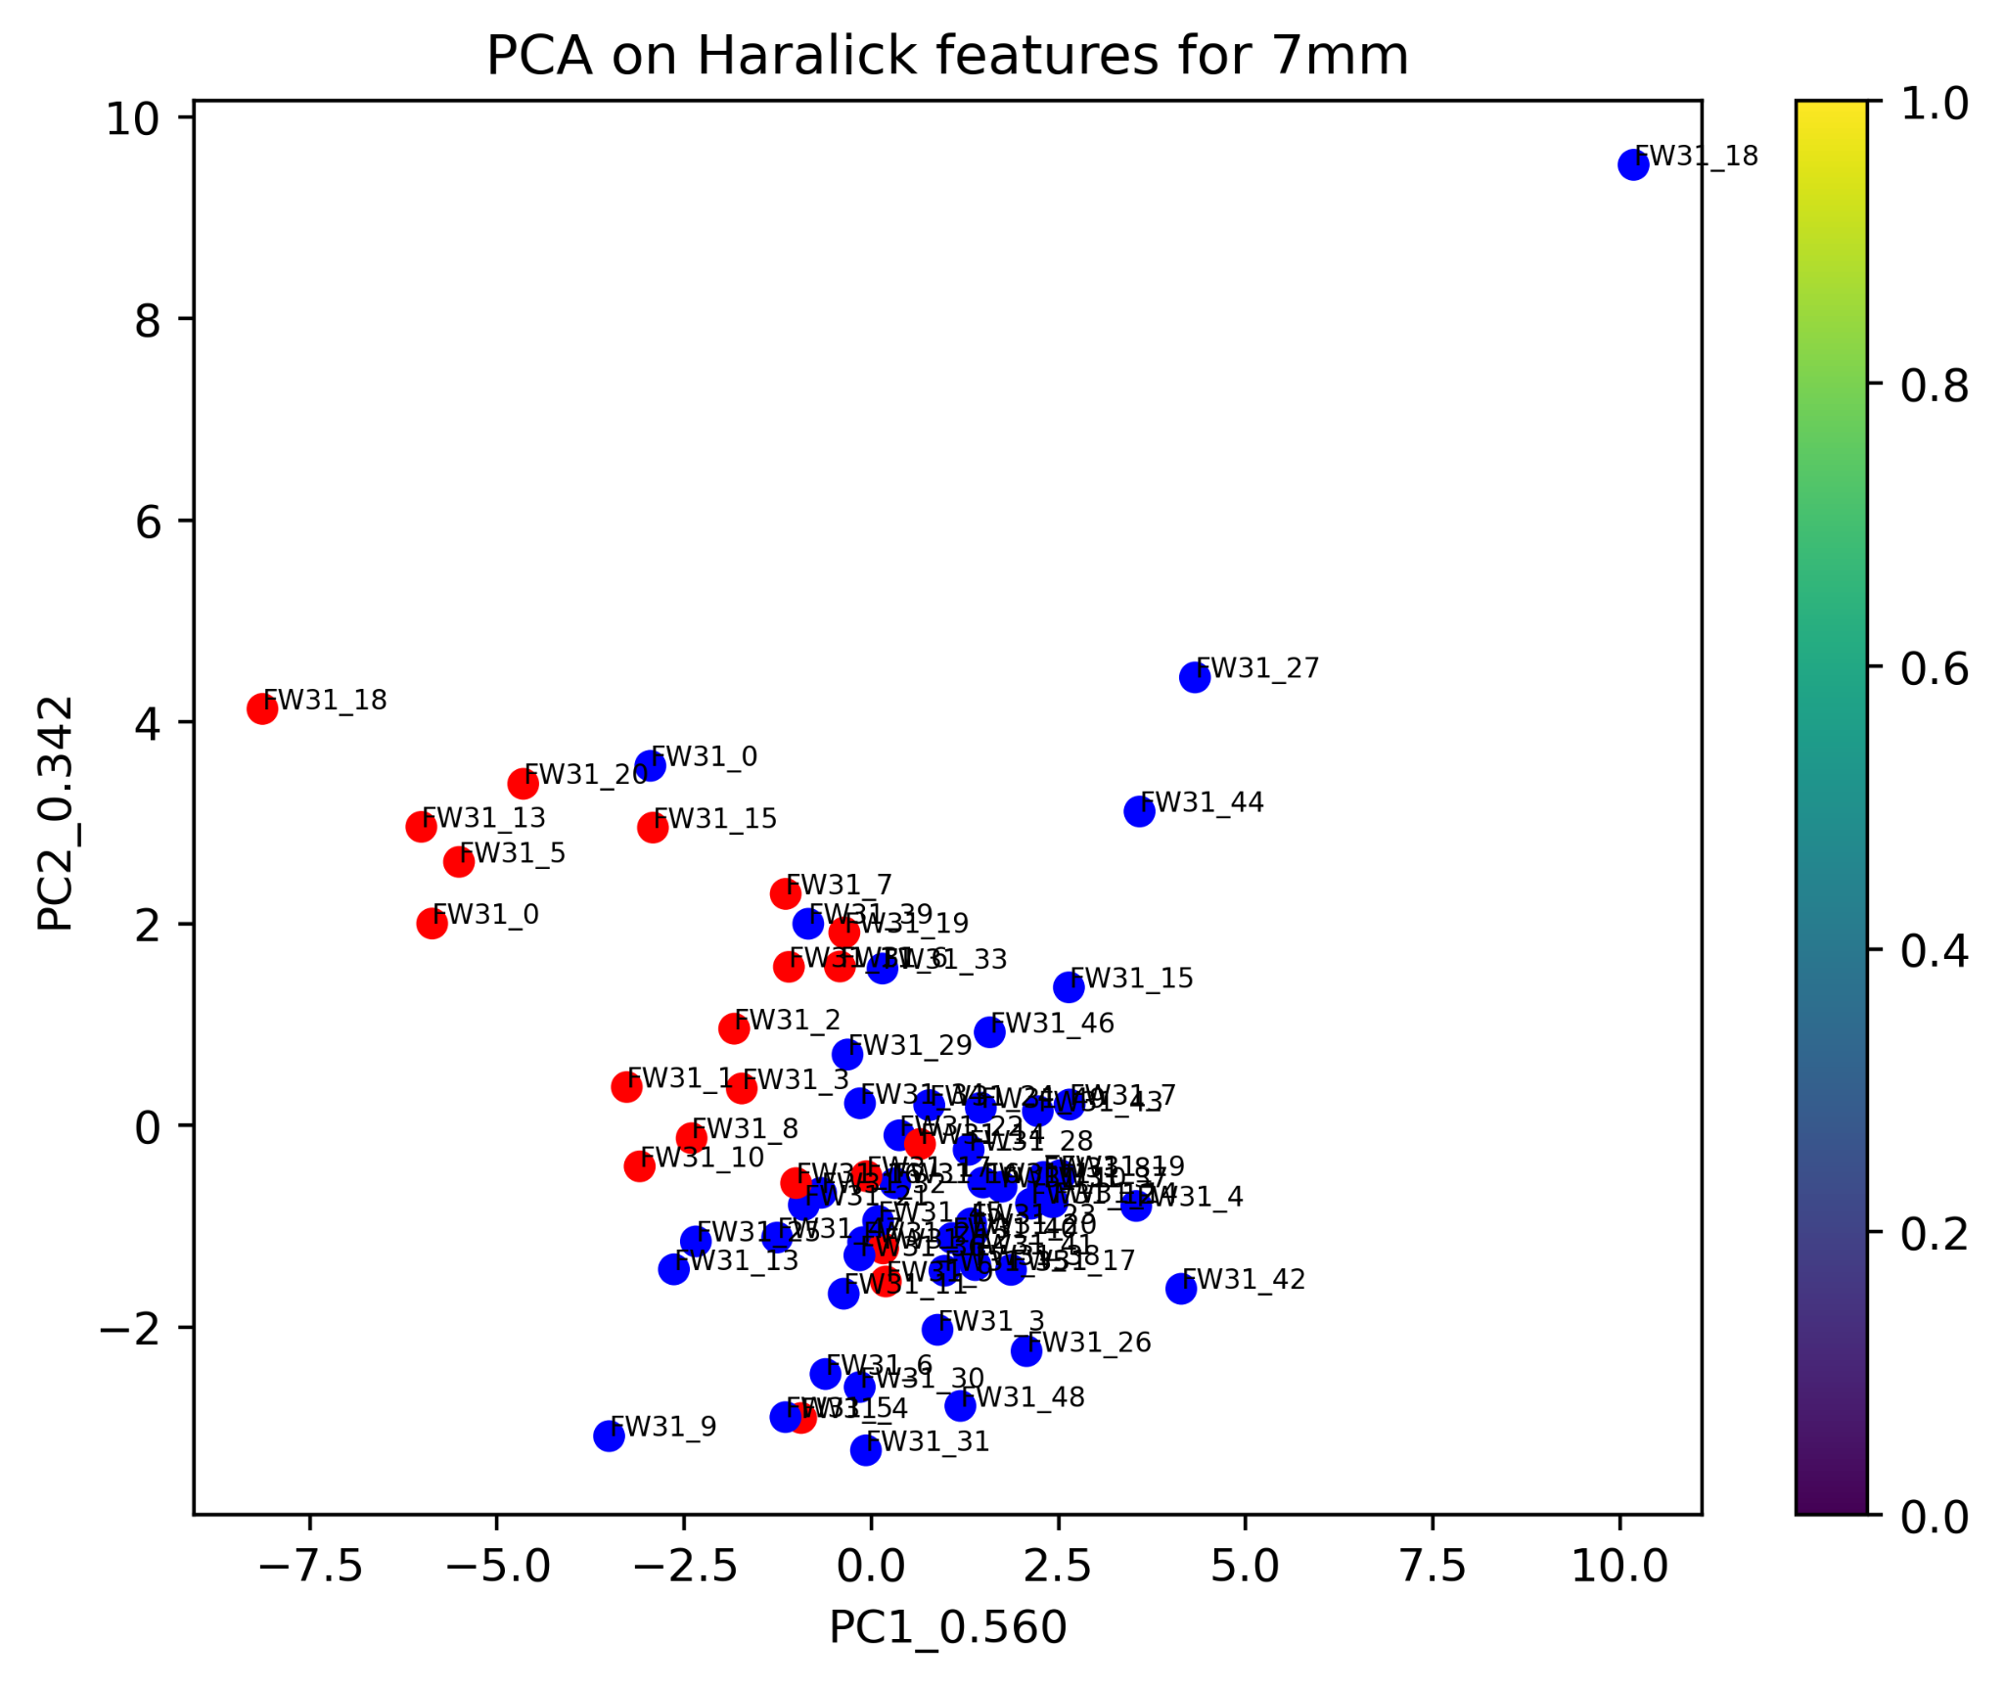
PCA on Haralick features

Slide 23
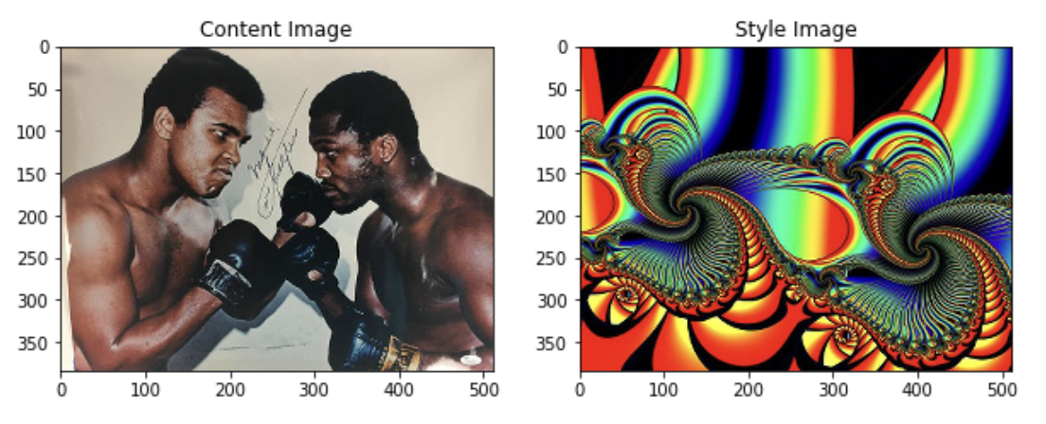
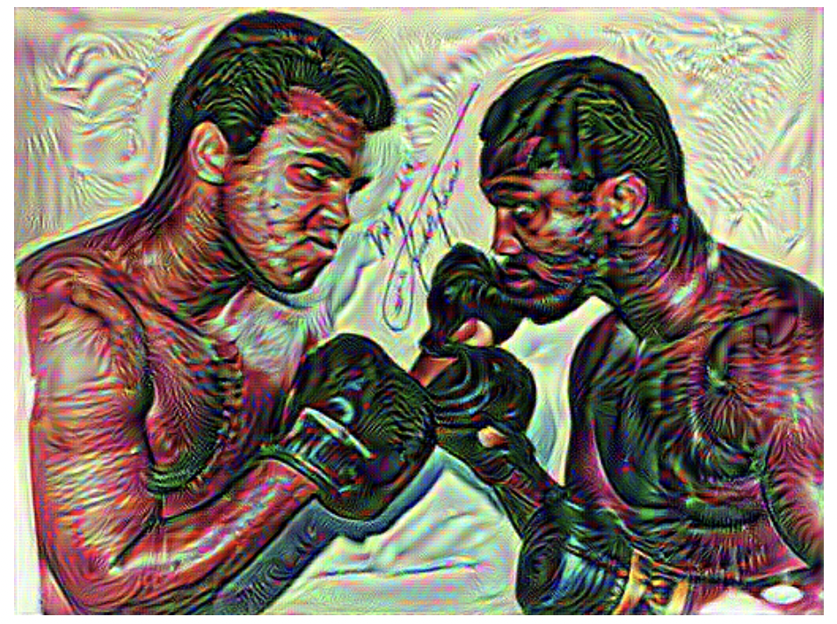
Neural style transfer
Output image

Slide 24
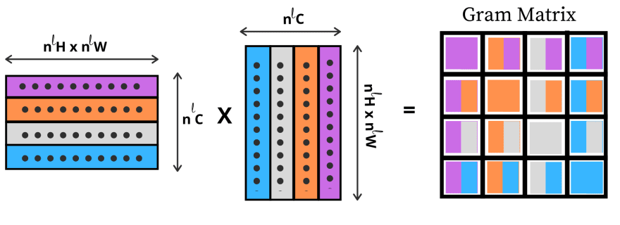
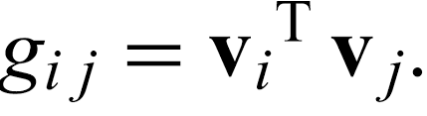
Gram matrix

Slide 25
Resnet50 and VGG19
VGG19 and Resnet50 are pre-trained Machine learning models.
VGG19 contains 19 layers on convolution layers while Resnet50 contains 50 layers of convolutional layers
Resnet50 is faster because it produces less parameters than VGG19

Slide 26
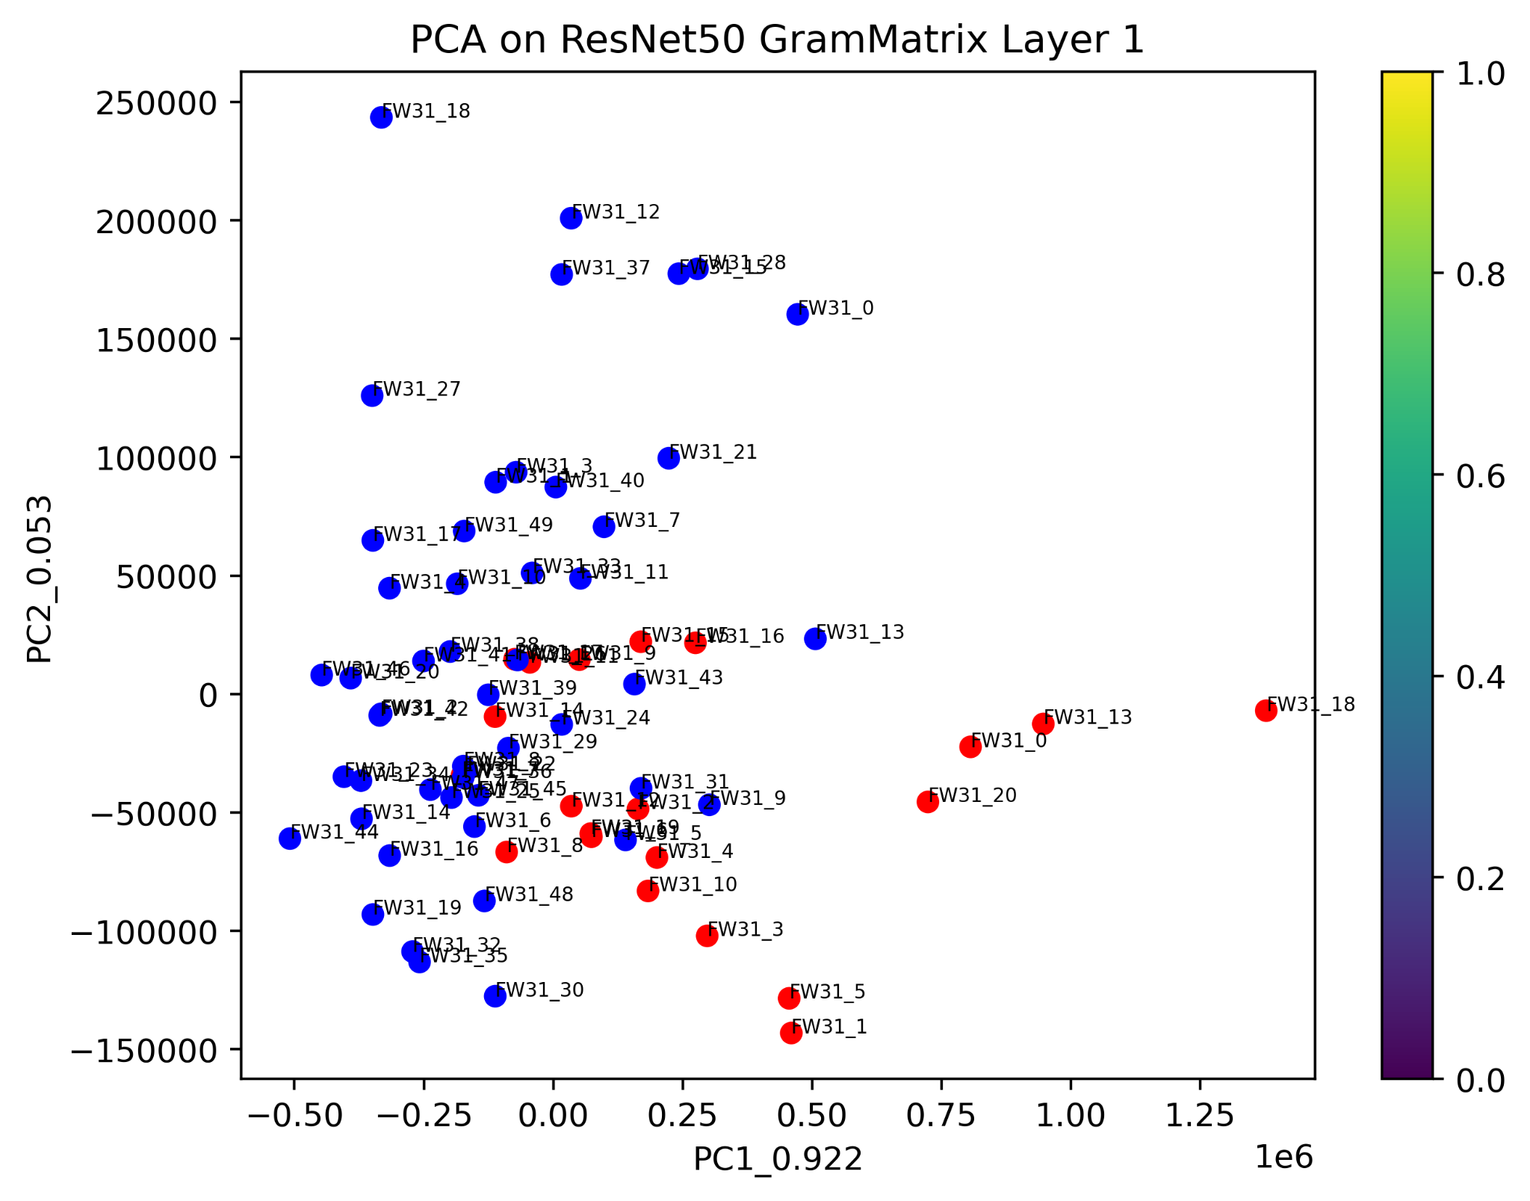
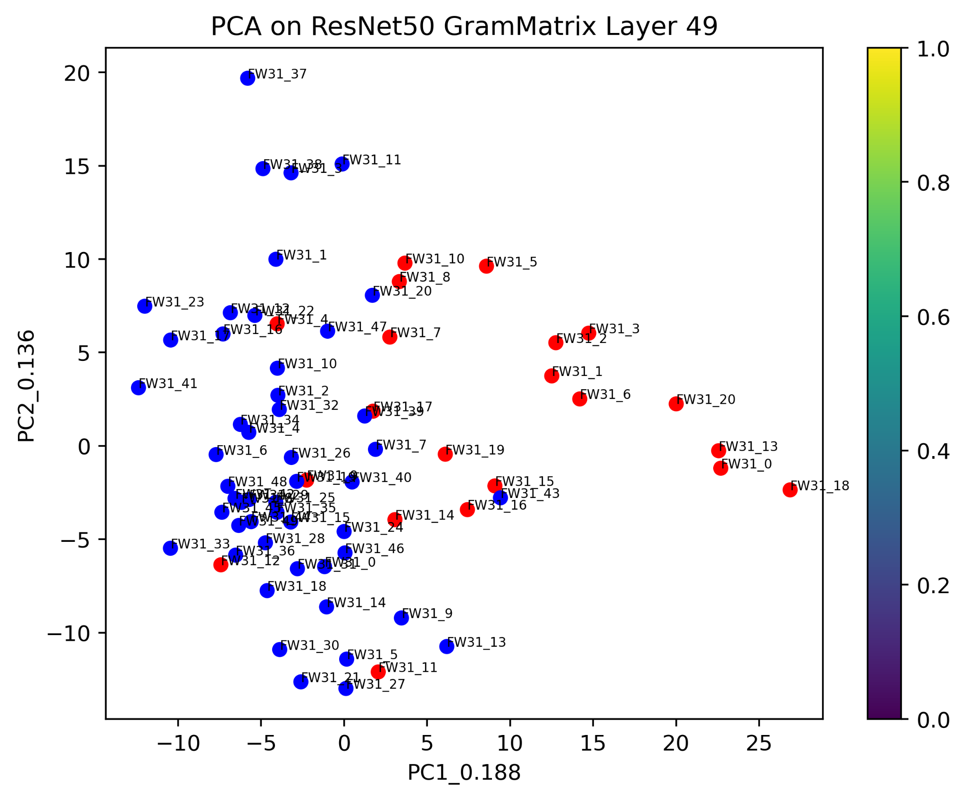
Resnet50 output of 5mm cut
1st layer of 5mm images
49th layer of 5mm images

Slide 27
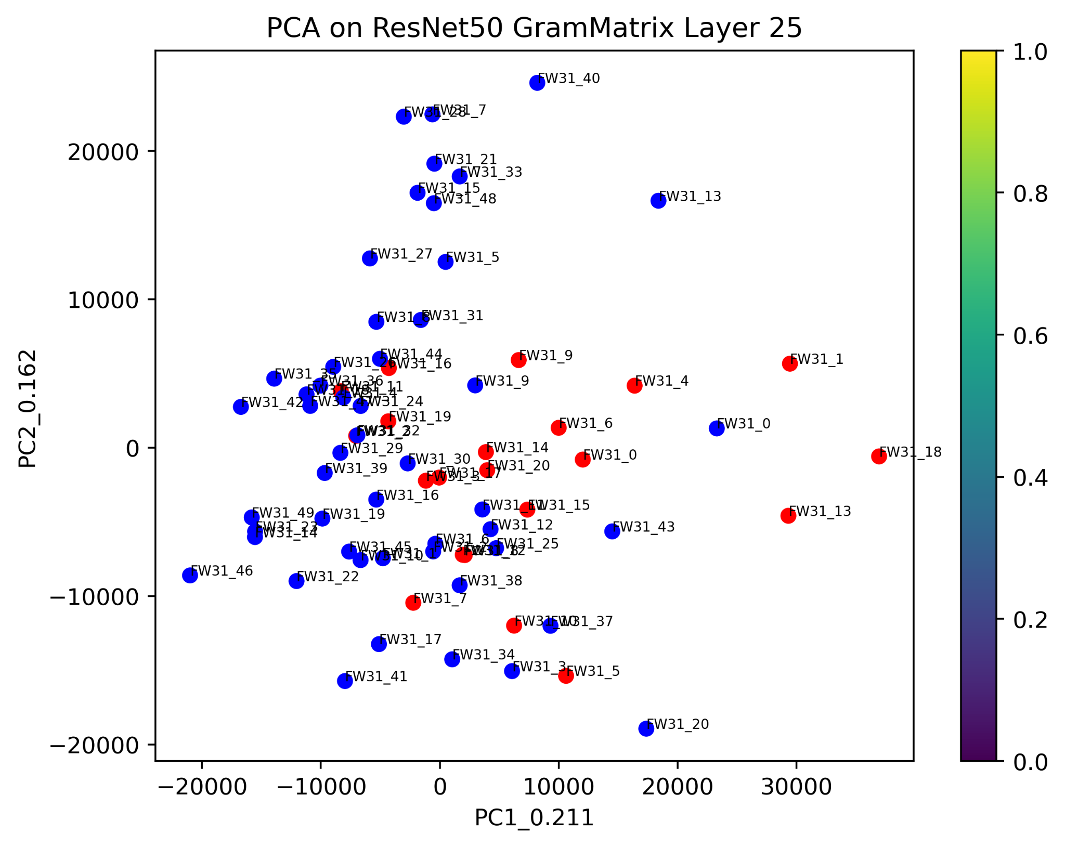
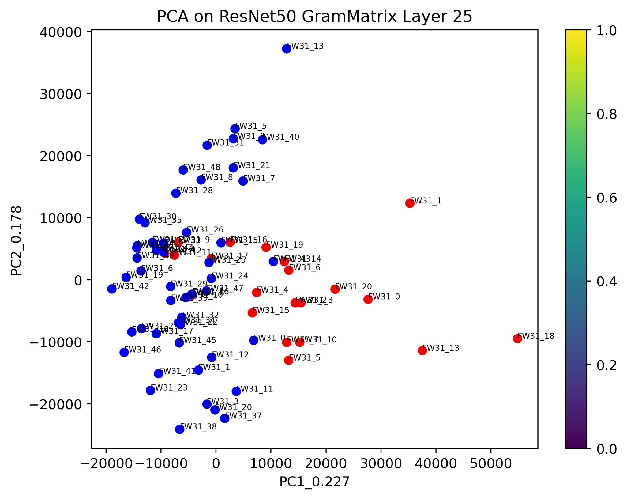
Resnet50 output of 1mm and 3mm cut
25th layer of 1mm images
25th layer of 3mm images

Slide 28
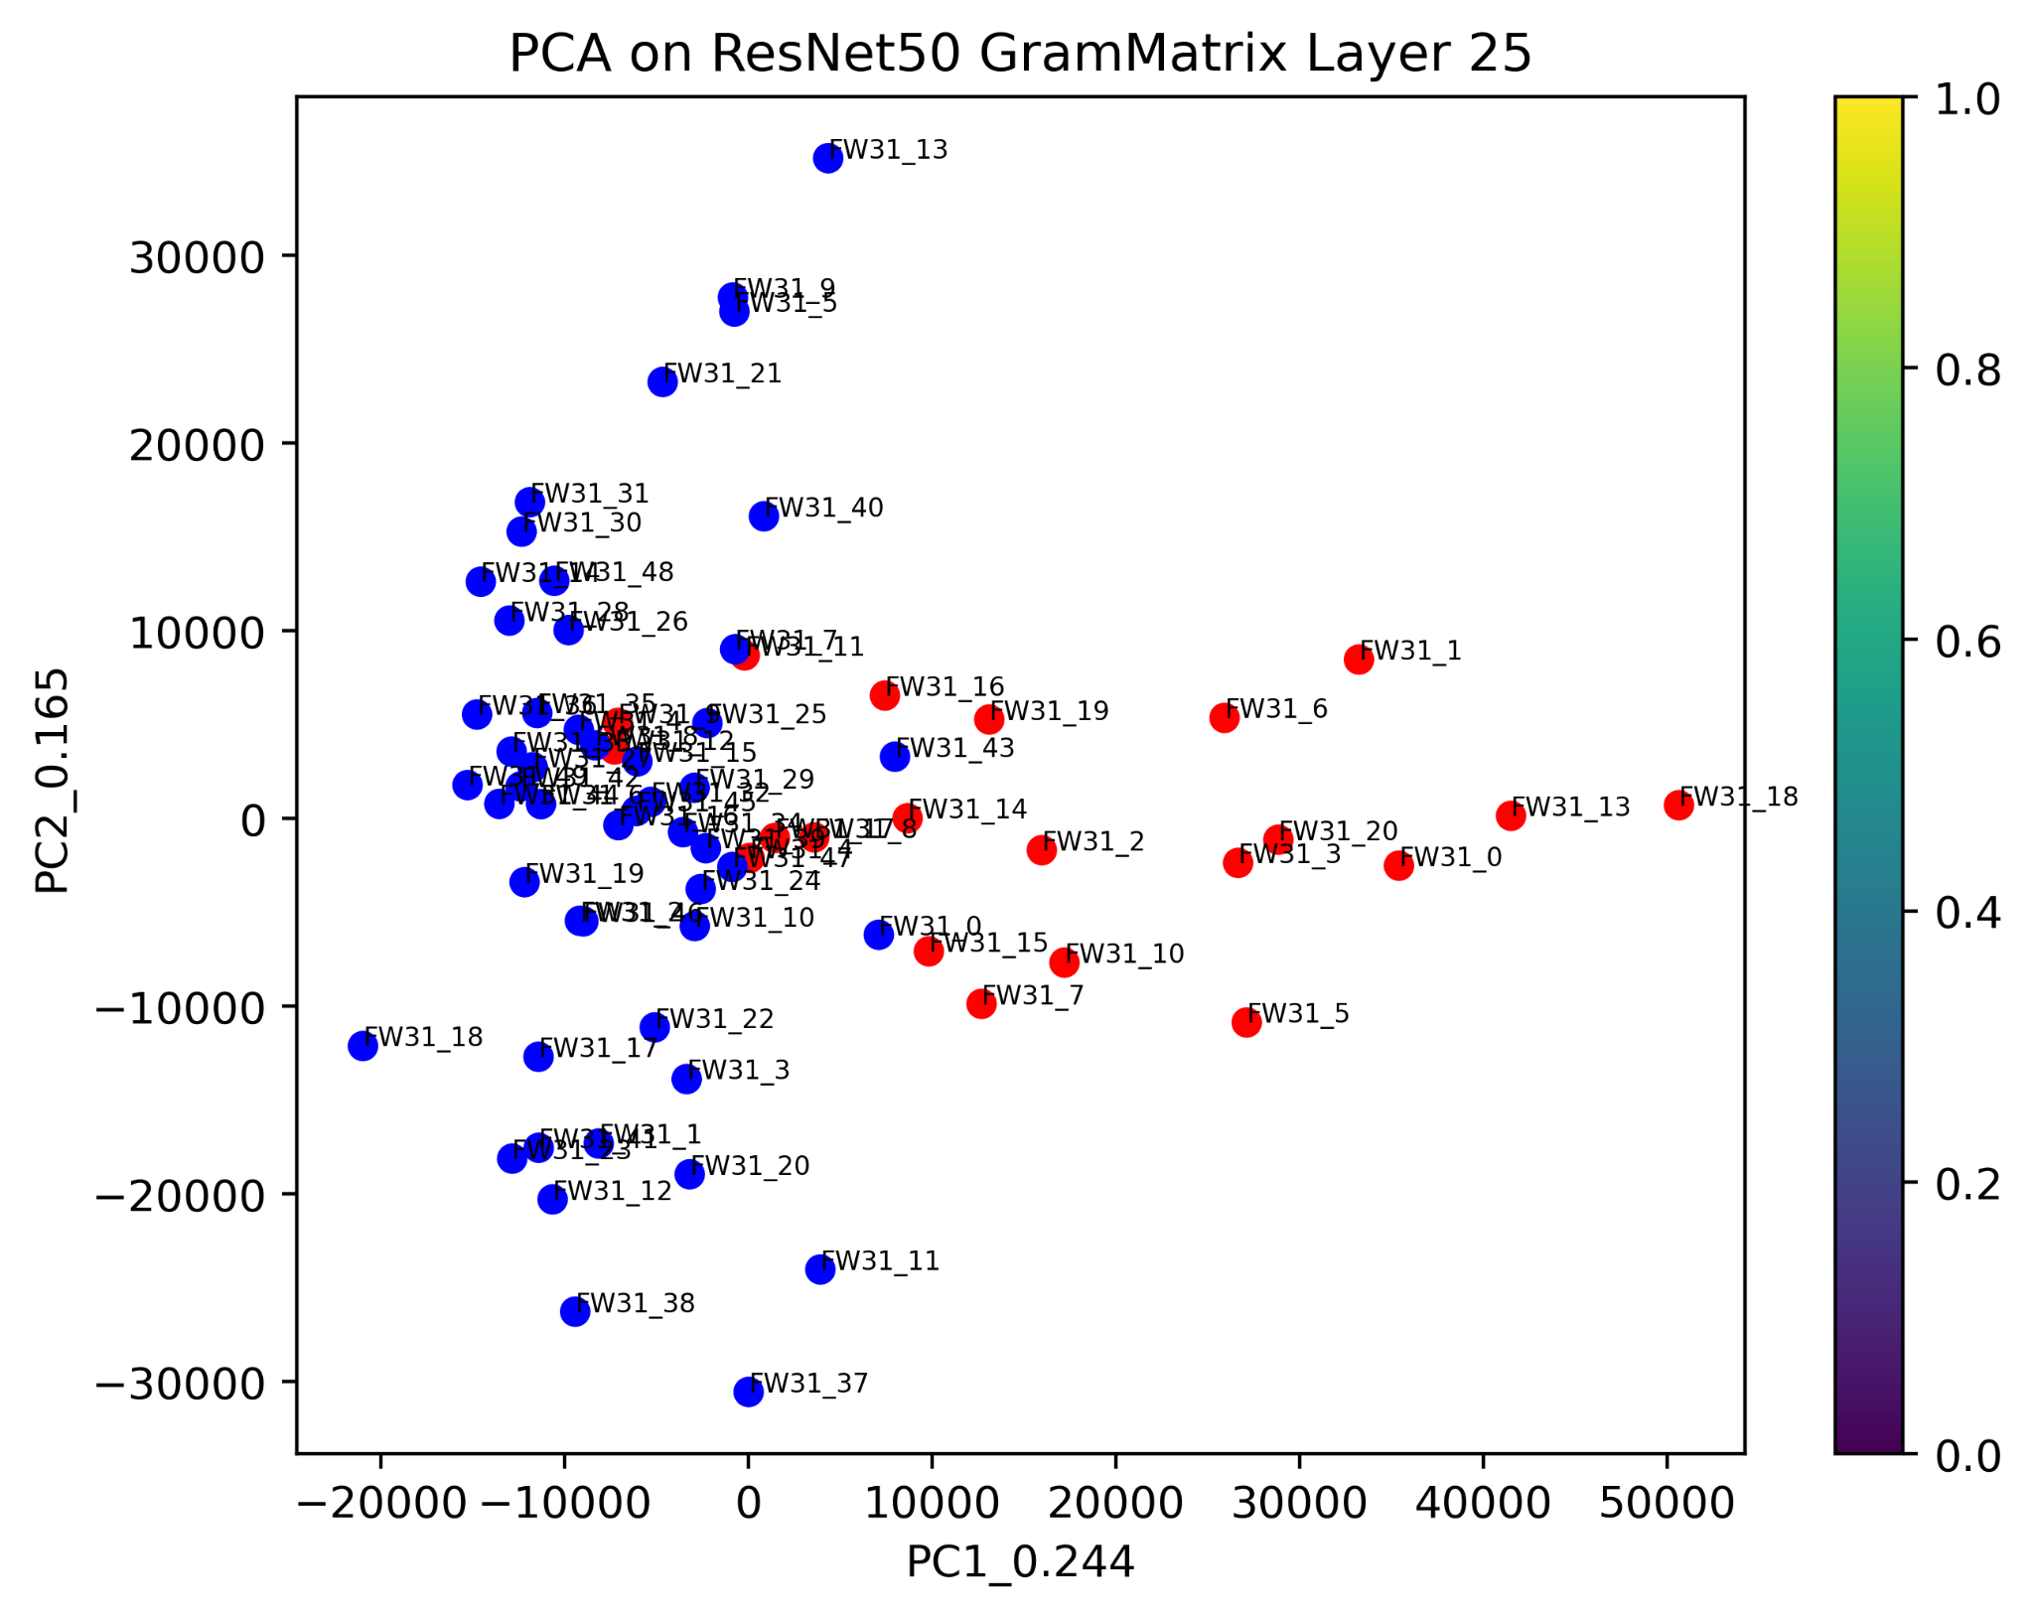
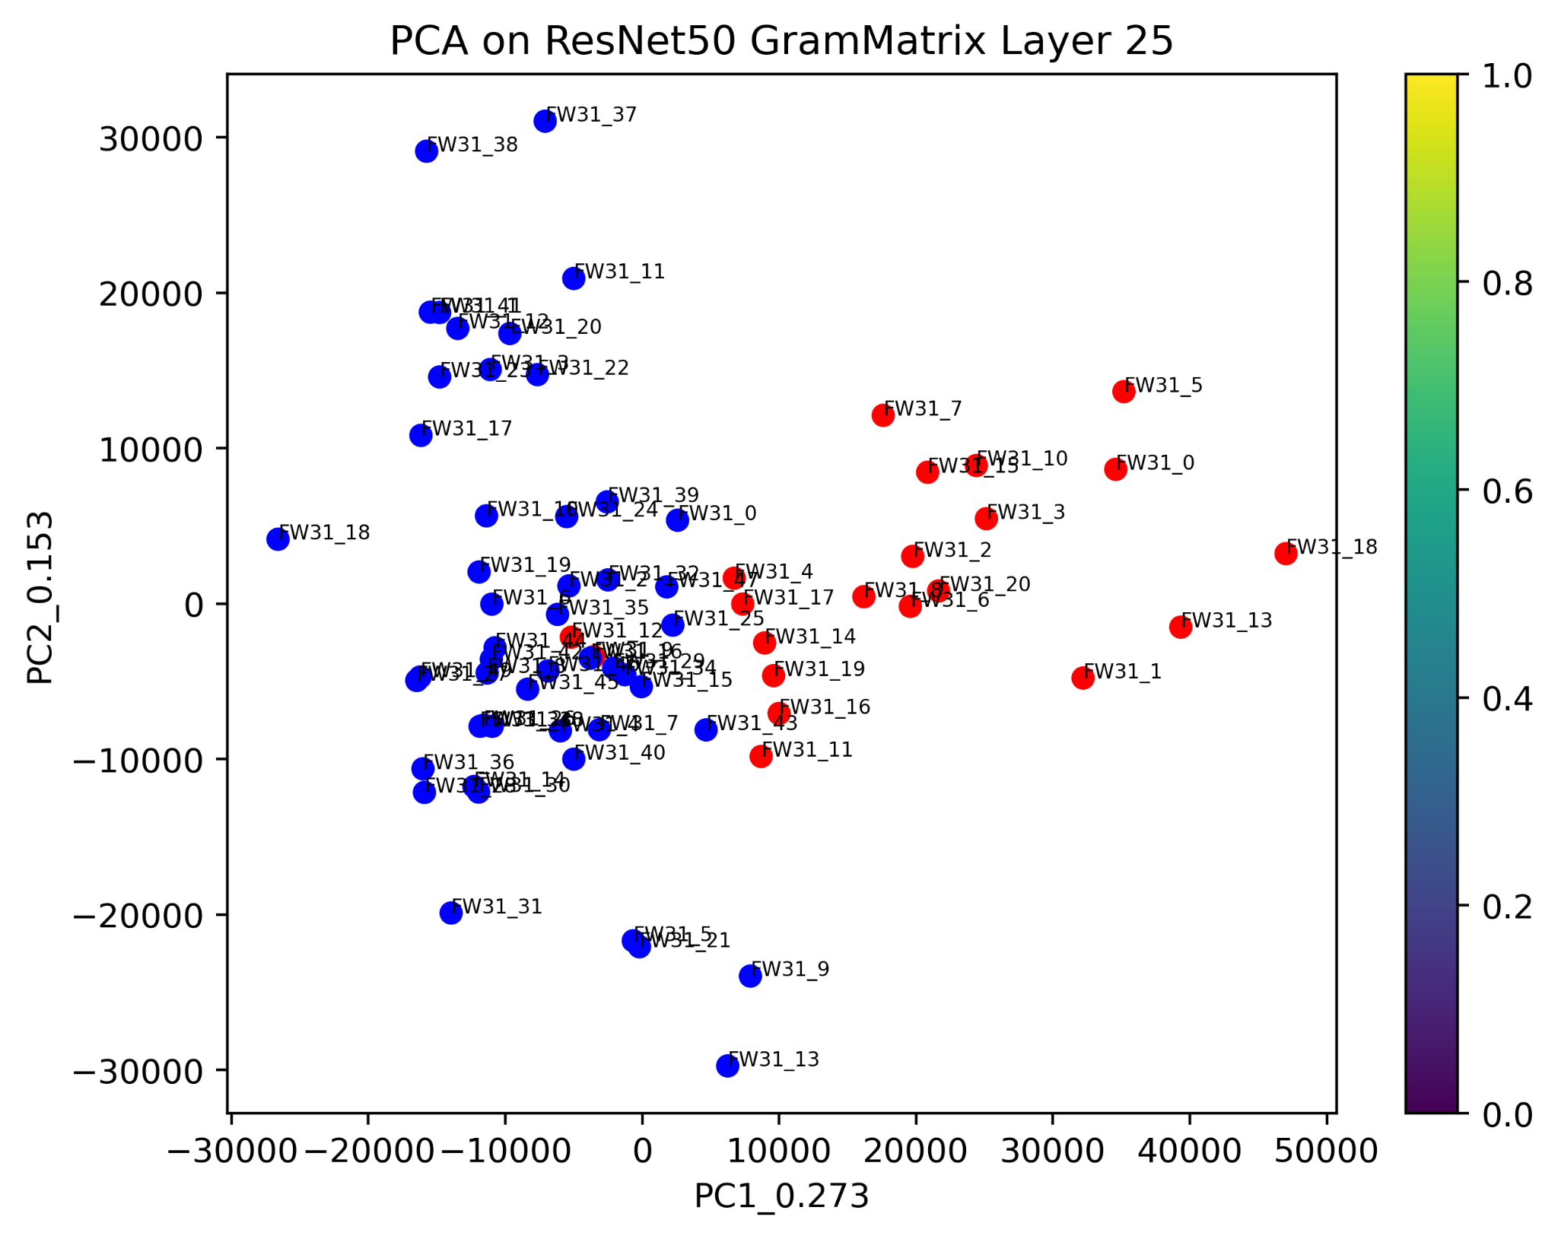
Resnet50 output of 5mm and 7mm cut
25th layer of 5mm images
25th layer of 7mm images

Slide 29
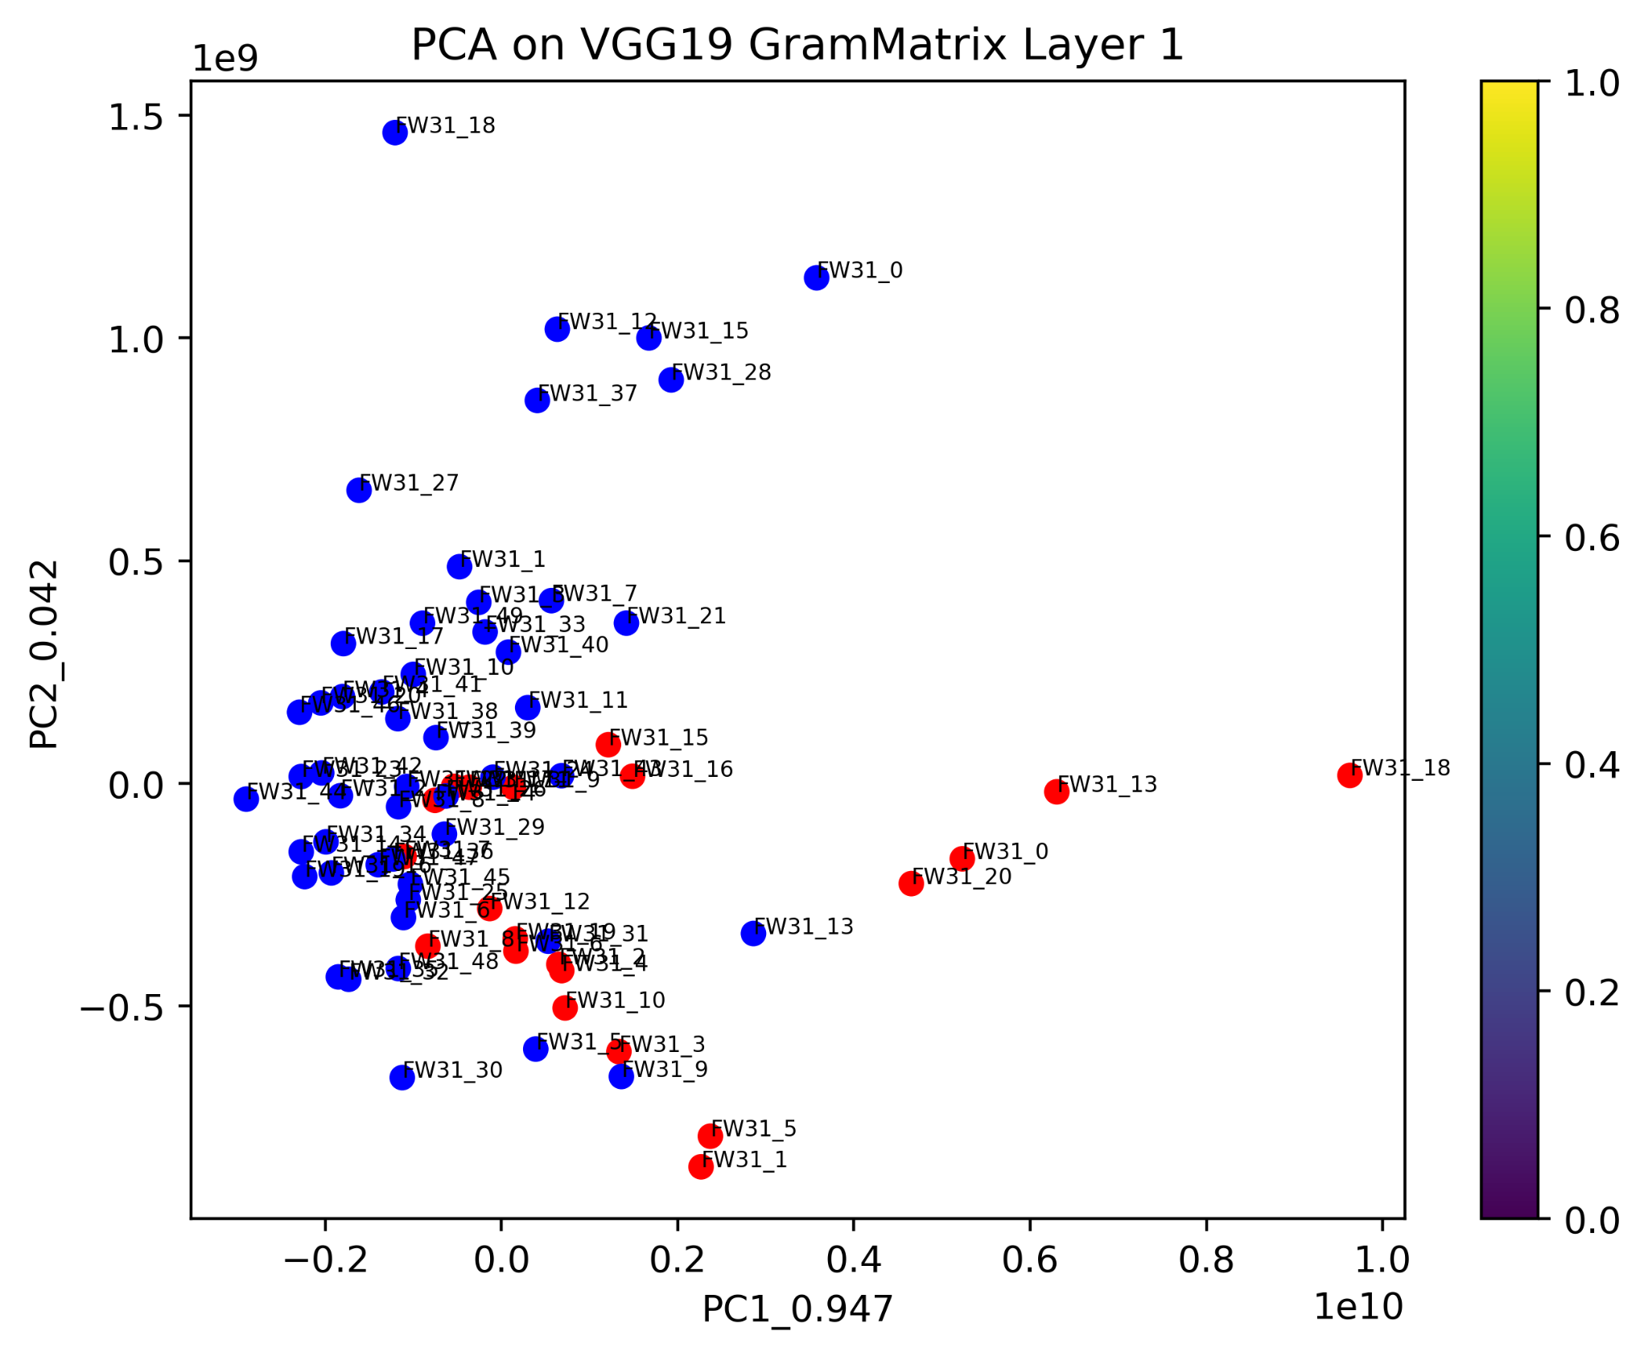
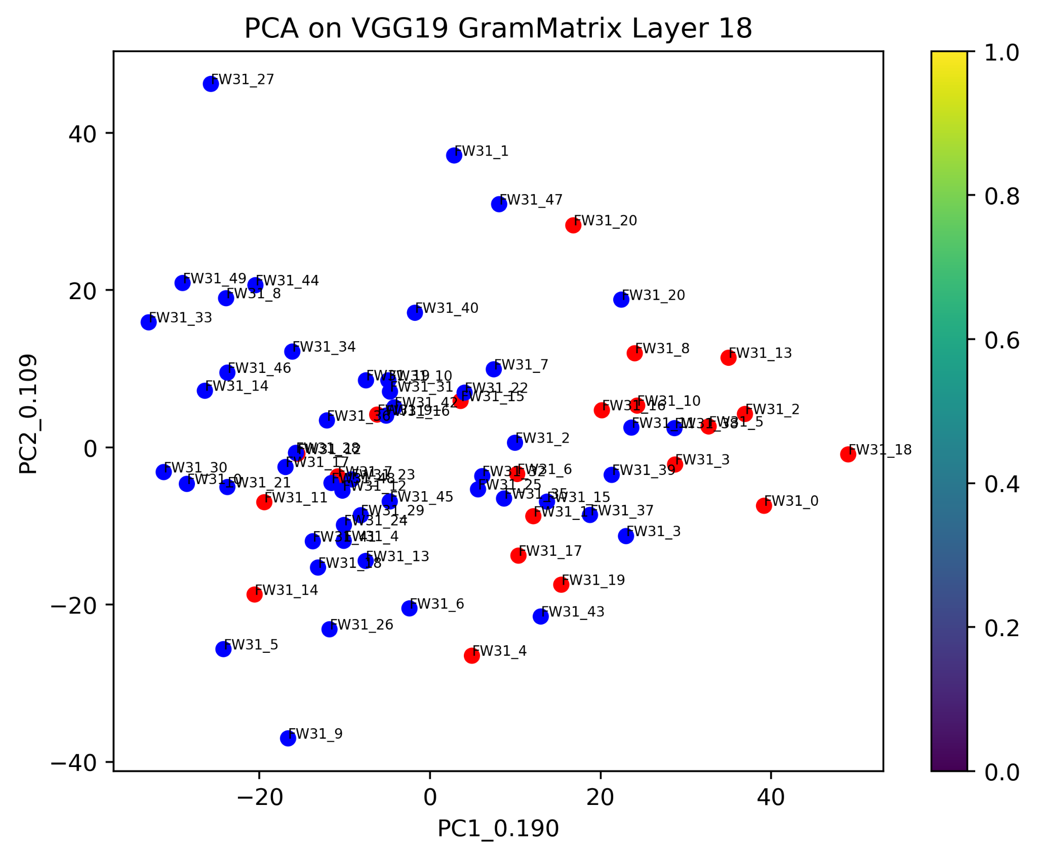
VGG19 output of 5mm cut
1st layer of 5mm images
18th layer of 5mm images

Slide 30
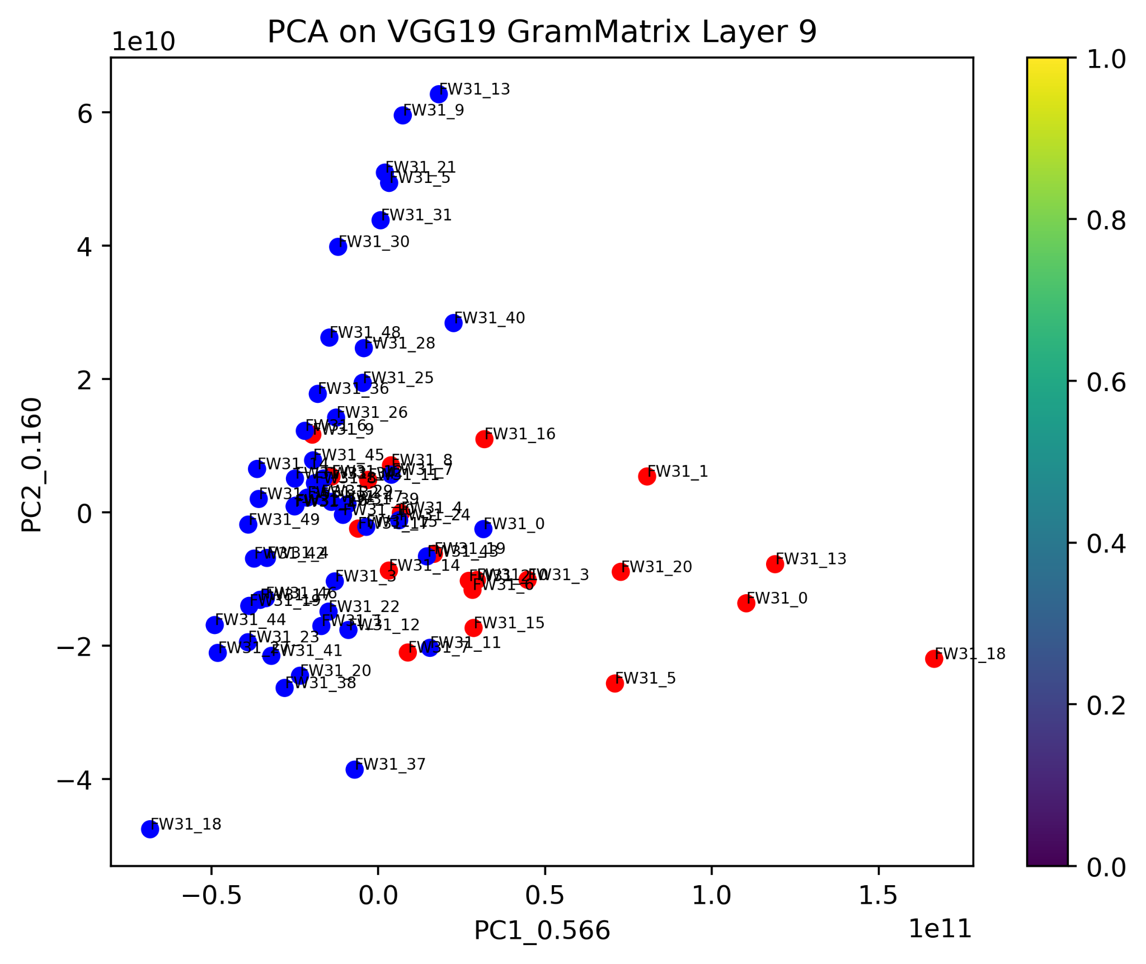
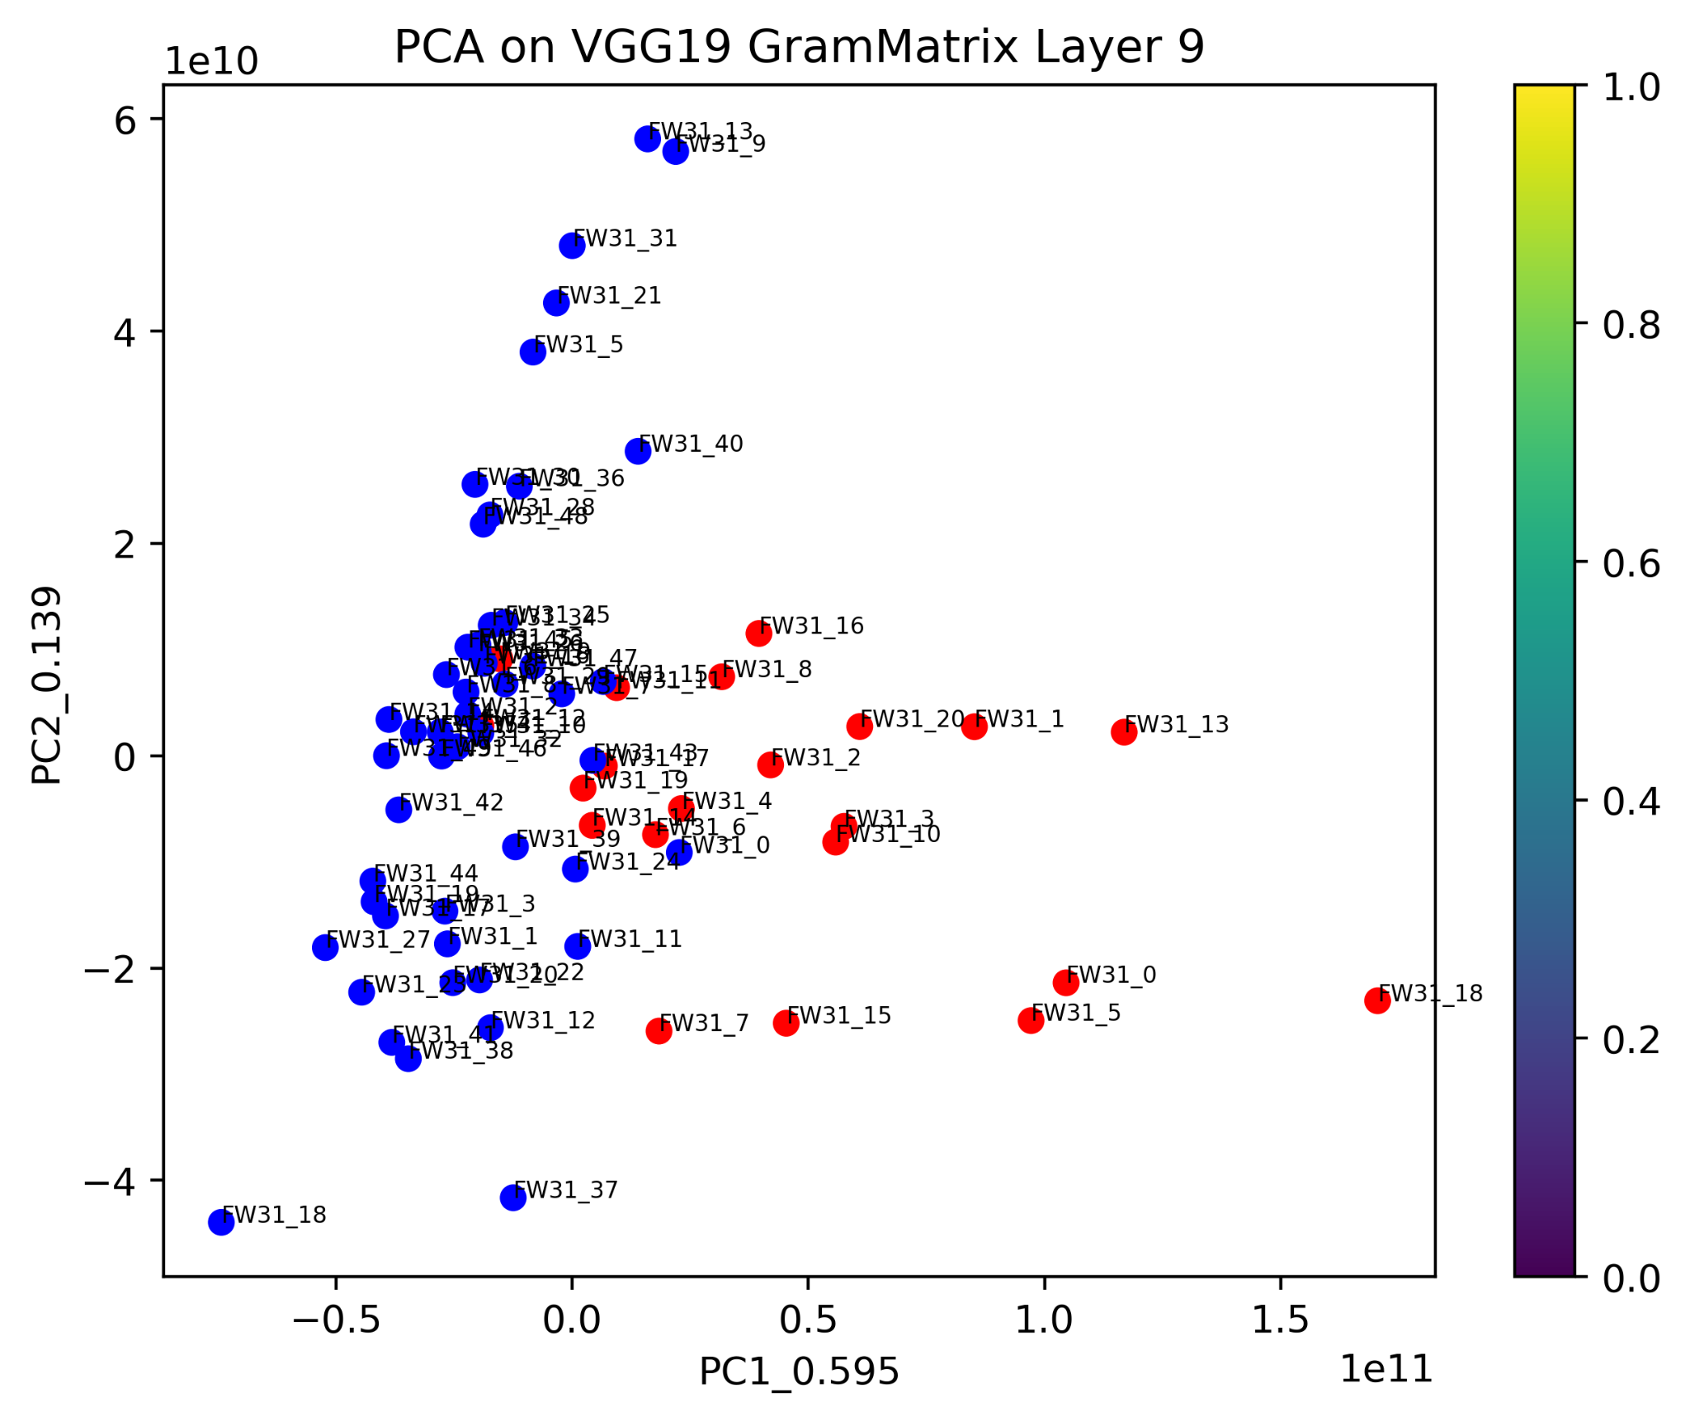
VGG19 output of 5mm and 7mm cut
9th layer of 5mm images
9th layer of 7mm images

Slide 31
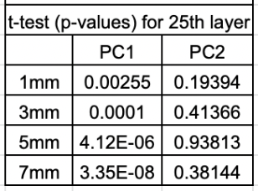
t-test on PCA values of Resnet50 model of all image sizes

Slide 32
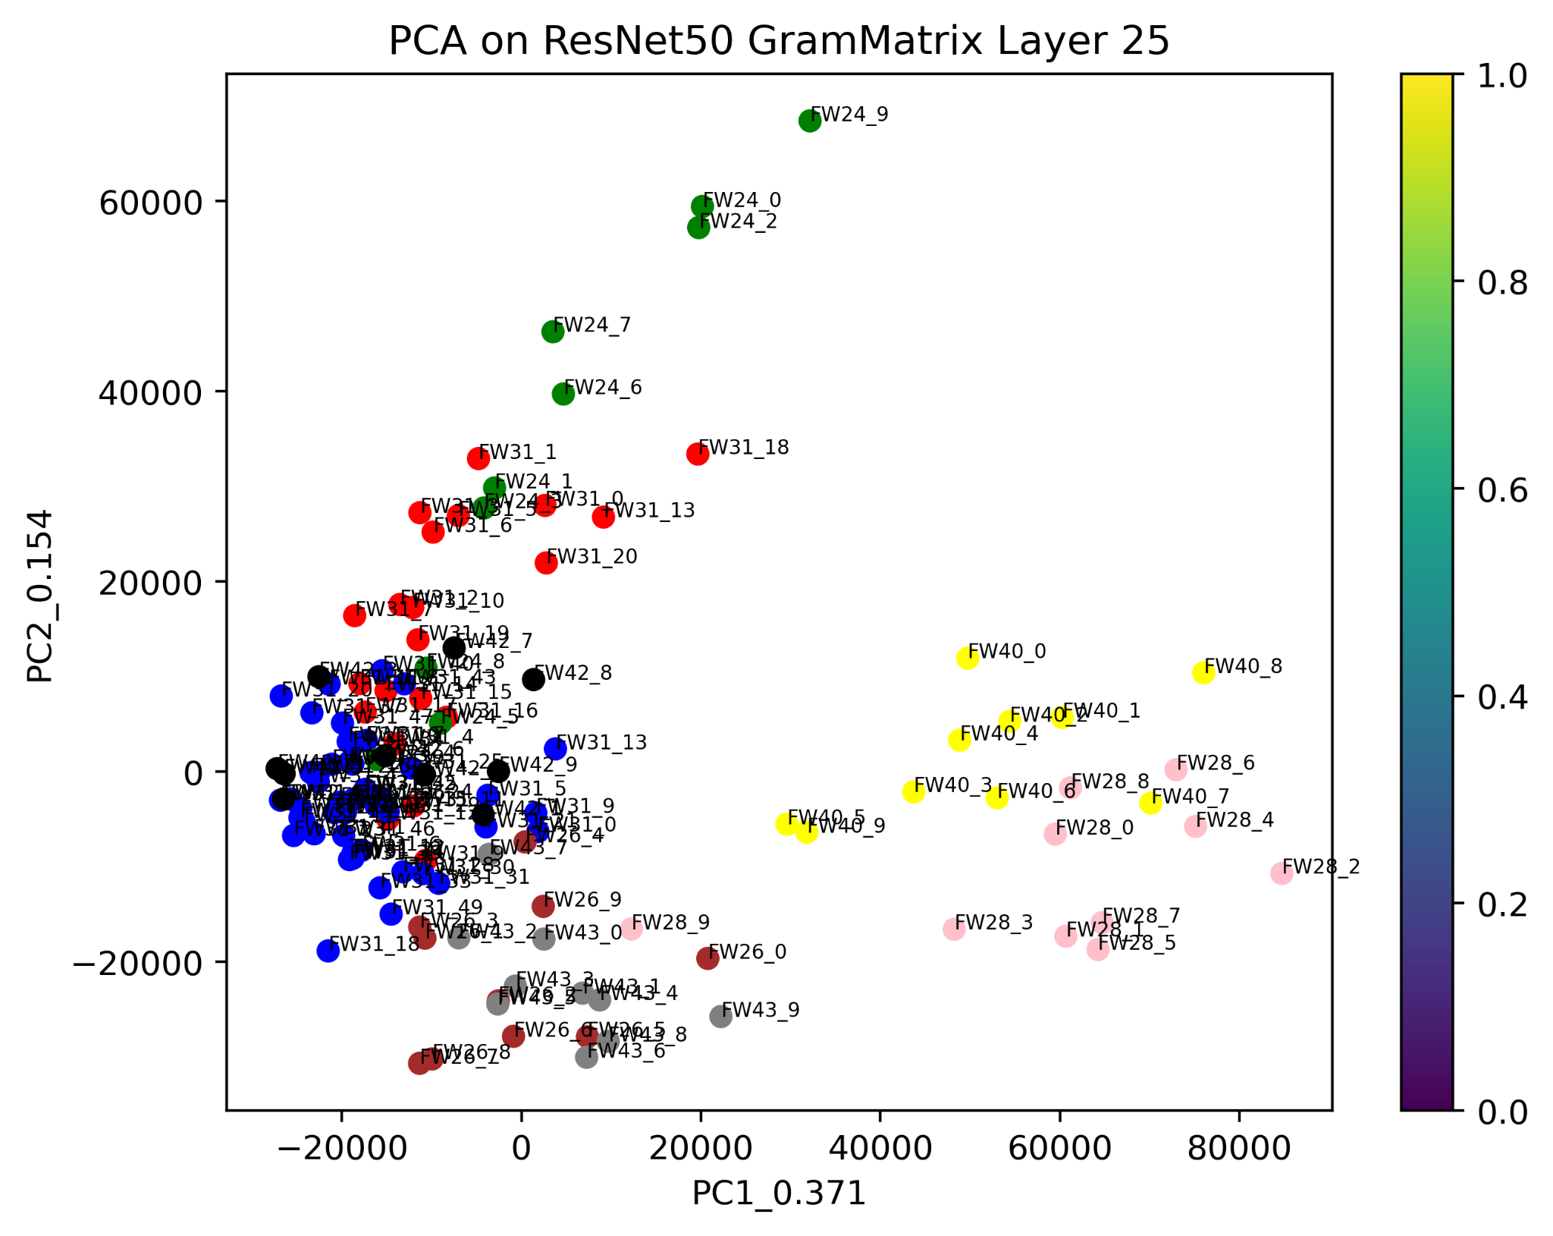
Resnet50 output of 5mm images of all wood

Slide 33
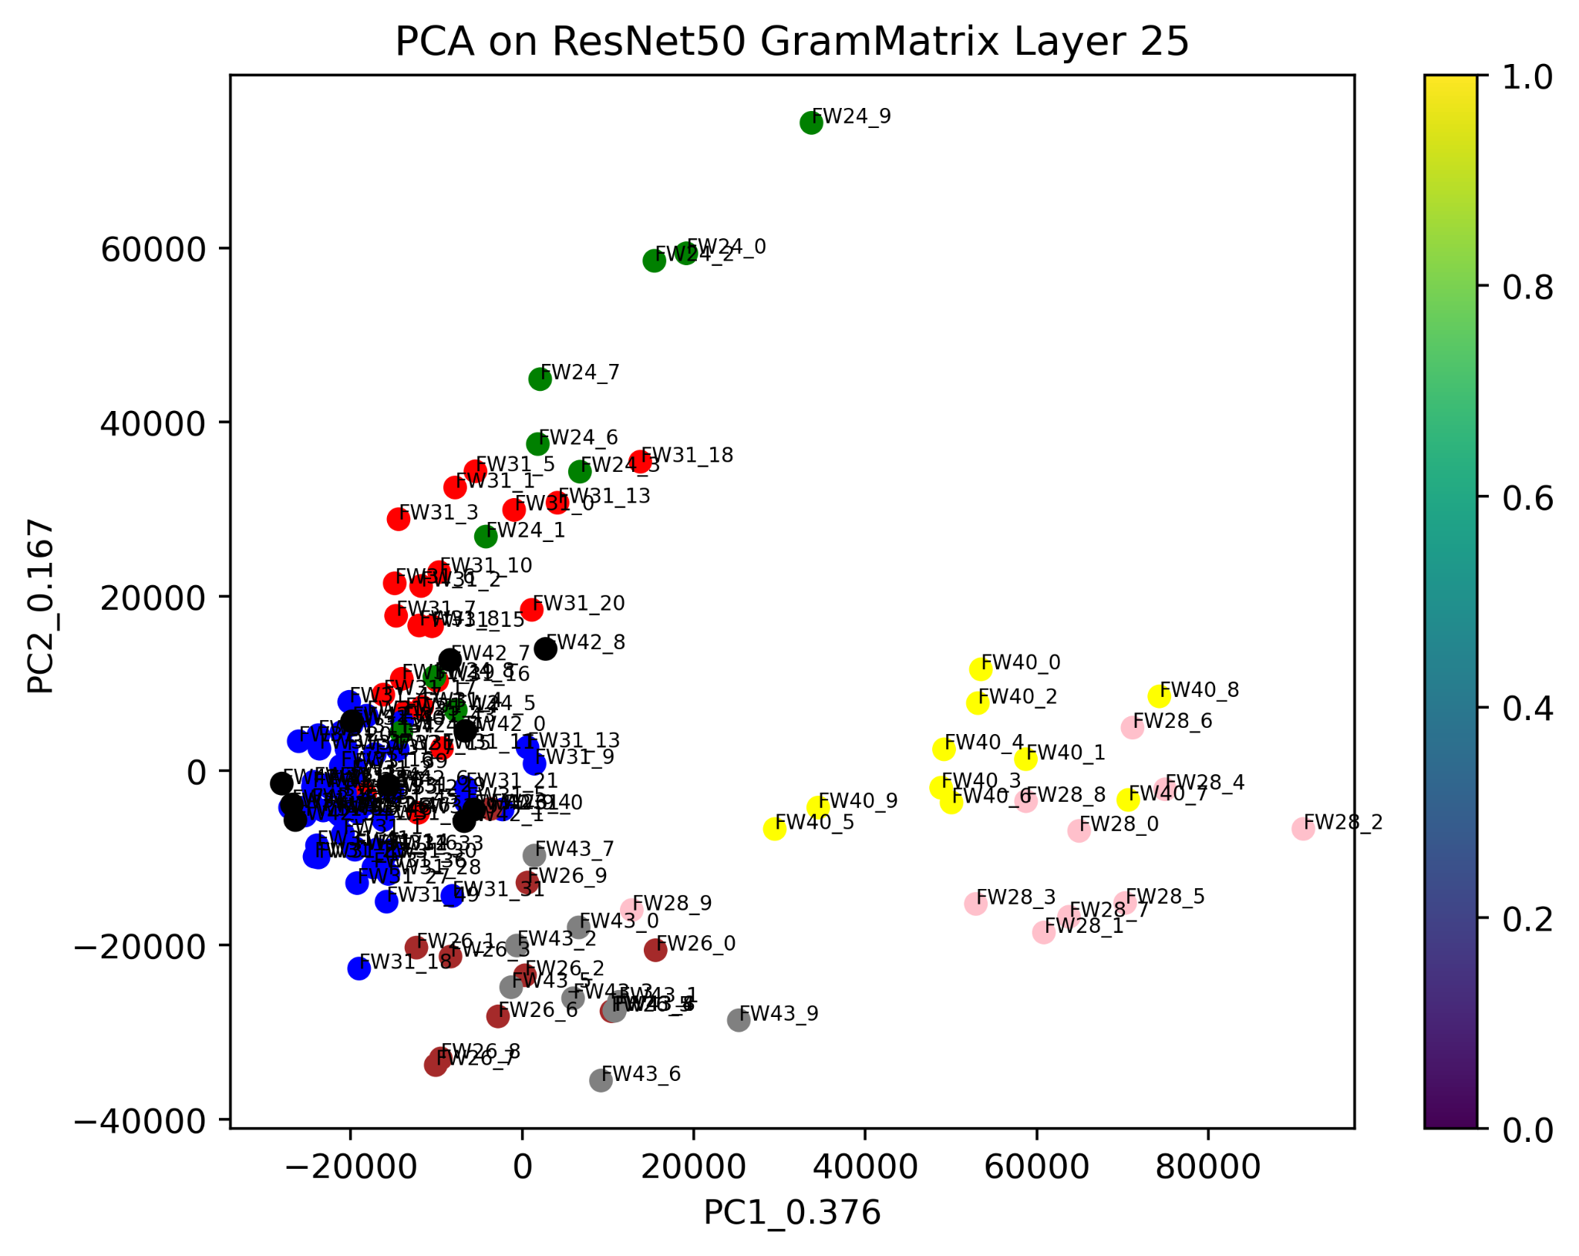
Resnet50 output of 7mm images of all wood

Slide 34
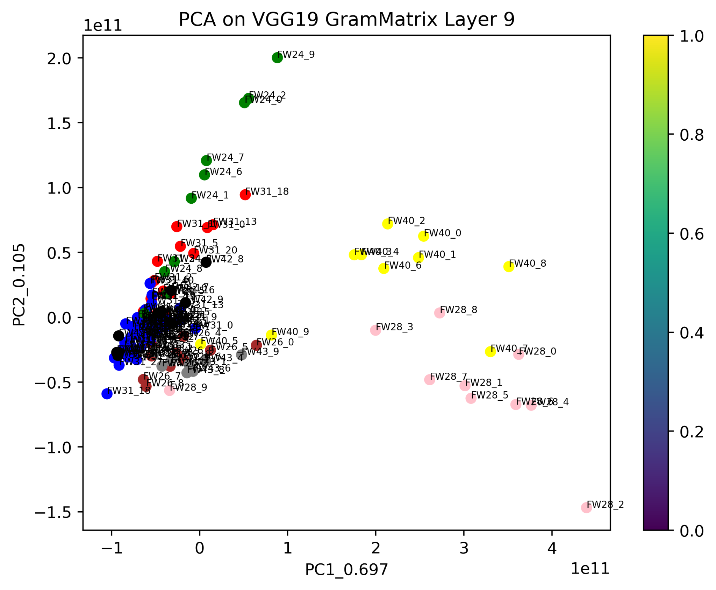
VGG19 output of 5mm images of all wood

Slide 35
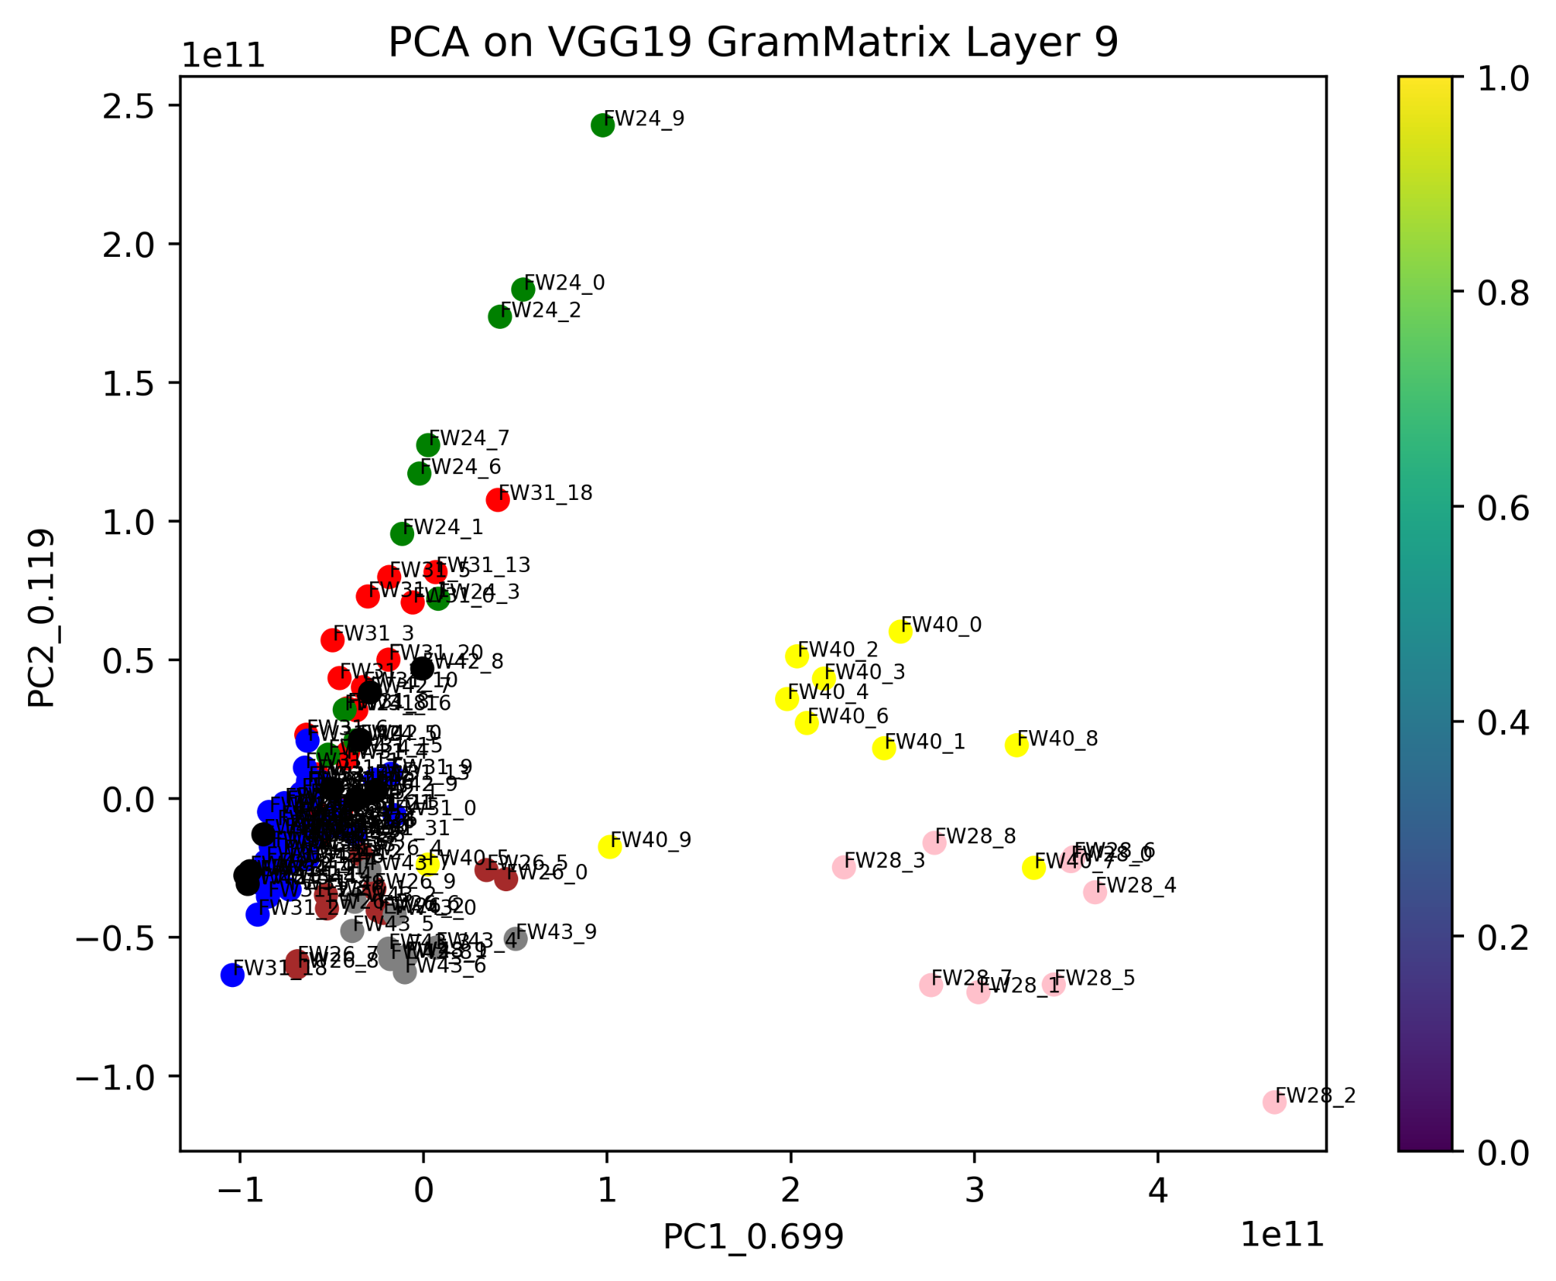
VGG19 output of 7mm images of all wood

Slide 36
Conclusions
It is observed that Correlation, Sum entropy, Information measure of correlation-2 are the best out of the 13 haralick features for coula species.
Found out a method to use GLCM to return the matrix images which measures intensity contrast between a pixel and its neighbour pixel over the whole image.
From the results it shows us there is high intensity in the diagonals and the thicker lines shows the variation between the pixels of both the damaged and undamaged area.

Slide 37
Conclusions
Using PCA on pre-trained models is better than using PCA on haralick features to distinguish patterns in image
Middle layer (25th for Resnet50 and 9th for VGG19) is better than first and last layer
We can observe that using larger images like 5mm,7mm images give better results than 1mm and 3mm images.
We can observe that using Resnet50 model for classification is better than using VGG19 model.

Slide 38
Thank you

